Slide 1
Government payment digitization in albania
NPC MEETING
October 1, 2019
Holti Banka
Financial Sector Specialist
Payment Systems Development Group
hbanka@worldbank.org

Slide 2
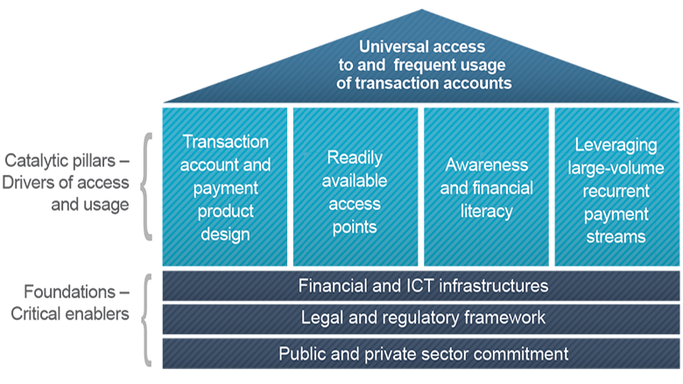
Why do government payments matter?
Government payments (e.g. public sector salaries, pensions, social transfers) constitute a significant portion of national retail payments (in volume) that occur on a periodic basis
When digitized, they can lead to higher financial inclusion, in terms of both access and usage of digital instruments
The government can show the way for other economic actors in the economy in terms of payment digitization
Even though in the case of Albania government payments have been digitized to a certain extent, there is still room for reaching complete end-to-end digitization
Government payment digitization was identified as one of the priorities in the National Retail Payment Strategy (2018) and a subsequent Note with recommendations was prepared by the World Bank
Source: Payment Aspects of Financial Inclusion (PAFI) Framework, World Bank 2016

Slide 3
recommendations
Consider channeling more pension payments through bank accounts
While theoretically pensions can be disbursed via a bank account, the vast majority are disbursed through postal offices
The Social Security Institute (SSI) can reduce administrative costs by channeling payments to bank accounts via the ACH
This might require system upgrades from the SSI
Consider expanding the e-Albania portal in terms of the number of government services (central and local) that can be paid and also the number of payment methods that can be used (in addition to cards)
Consider re-assessing the structure of transaction fees for government collections
Government agencies should examine absorbing transaction fees of government collections made through banks (and other PSPs), or at least share some of the fees with the users
Regardless of who pays the fees, the use of electronic instruments and channels should be incentivized by differentiating the fees for those options vis-à-vis cash

Slide 4
recommendations
Consider providing direct access to the ACH for non-bank PSPs
Beneficiaries should be able to choose the type of account and institution to receive the payment
The Treasury should consider making public salary payments directly to the bank accounts of beneficiaries through the ACH
This would reduce costs for government and back-office work and reconciliation from banks
Reconciliation would be quasi automatic, caring only for confirmation on the payment having been received in the recipient account
Further coordination between Treasury and Public Administration Office (DAP) is needed
Ultimately it is the Treasury that needs to execute the payment order, using data provided by DAP on the beneficiary information
Consider establishing a working group in the context of the National Payments Committee to examine the topic of government payment digitization

