Slide 1
Inflation drivers and monetary policy normalisation in the Euro area
Dr. Birgit Niessner, Director of Economic Analysis and Research Department
October 2022
www.oenb.at

Slide 2
Energy and food prices determine inflation developments in the Euro area
Surge in HICP inflation since 2021
Food and energy prices as main inflation drivers
Core inflation (HICP inflation excl. food and energy) since Q4/2021 above 2% (4.8% in September 2022):
  Core inflation driven by supply chain disruptions, pass-through of high commodity prices, reopening effects
HICP inflation expected to stand at 8.1% in 2022 but subsiding in the upcoming years

Slide 3
Higher commodity prices and stronger pass-through from wholesale to consumer prices drive energy and food inflation
Surge in international natural gas price in 2021 driven by Euro area gas prices (Russian export policies)
Stronger pass-through from wholesale energy prices to consumer energy prices
Cost pressures on food prices (high energy input costs, high prices for fertilisers and food commodities)
High level of uncertainty around energy and food prices due to Russia‘s war in Ukraine

Slide 4
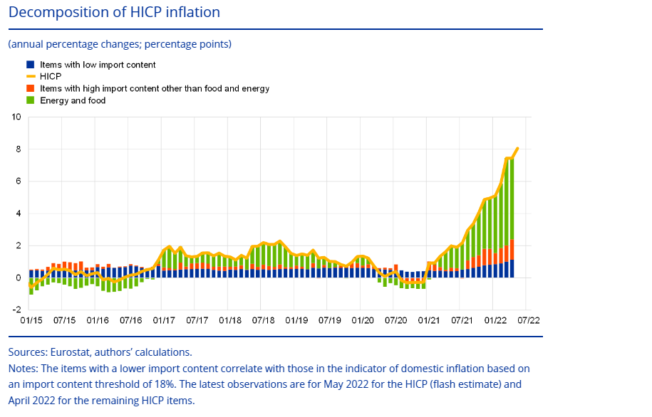
High import intensity of inflation drivers
Surge in HICP inflation driven by prices with high import content (see Chart)
Energy and food items typically feature high import intensity
High non-energy industrial goods inflation due to persisting supply bottlenecks and pipeline pressures
  Import price inflation remains high in August 22 (29.7%), but is expected to moderate
  Producer prices further accelerated to 43.3% in August 22
Domestic inflationary pressures have increased recently

Slide 5
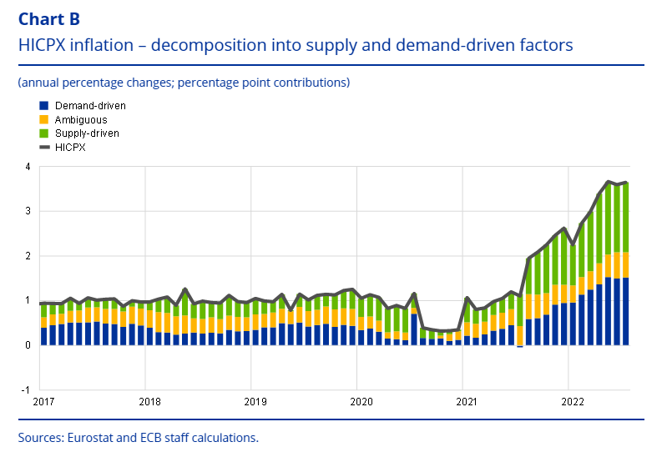
Supply- and demand-side factors contributed equally to surge in core inflation
Non-energy industrial goods inflation rather supply-driven:
  Slowly easing supply chain disruptions, but potentially new bottlenecks due to Russia‘s war in Ukraine and energy transition
Services inflation largely demand-driven:
  Upward effects on services prices from reopening

Slide 6
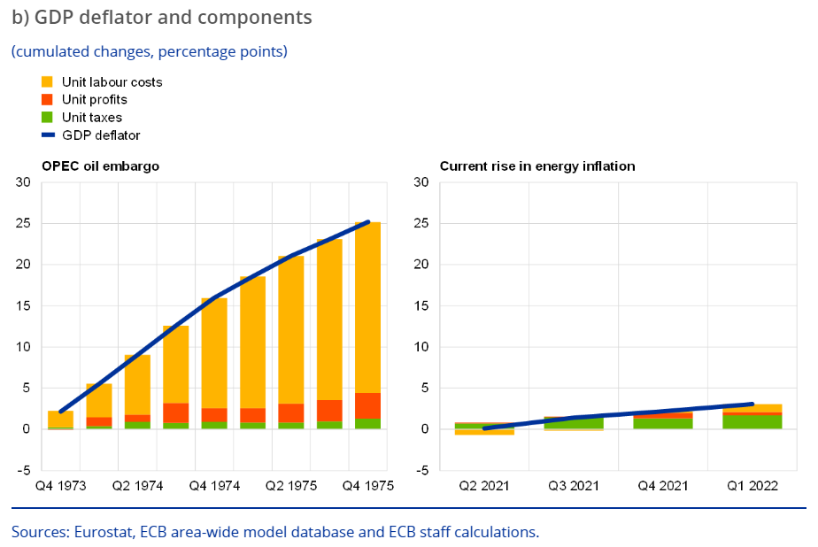
So far unit labour costs contributed little to increase in inflation
Recent increase in GDP deflator (until Q1:2022) in EA mainly driven by unit taxes and unit profits (see Chart)
Expected increase in unit labour costs due to tight labour market conditions and compensation for high inflation rates
Labour shortage increasingly reported as factor limiting production (EC Business and Consumer Survey)
Global trade outlook has deteriorated due to slowing momentum in goods trade
Sanctions on Russian economy and the high uncertainty involved are weighing on Euro area foreign demand

Slide 7
The impact of economic policy on inflation
Monetary policy (ECB + NCB)
Fiscal and social policies
Monetary policy normalisation
end asset purchase programmes, interest rate hikes
  Delayed effect
  Dampen demand moderately
Stabilise inflation expectations
Competition policies/ Transparency in price setting
  Longterm (no quick) effect
Income support measures Transfers, indexation of social benefits, cold progression, wage-related levies
  Targeted measures
  Potentially demand and inflation enhancing
Inflation dampening measures Indirect taxes, price caps, fee freeze
  Quick effect, but same for everyone
  Higher inflation is postponed in the future
Majority of fiscal measures as reaction to high energy prices in the EA has been non-targeted (impact on HICP inflation -0.6 pp in 2022)
Structural policies

Slide 8
What happened so far for exiting the highly accommodative stance
PEPP (Pandemic Emergency Purchase Programme)
In Q4/2021 the ECB Governing Council started
to lower the pace of net asset purchases
PEPP net asset purchases ended in March 2022
Principal payments from maturing securities are reinvested (with some flexibility) until at least
the end of 2024
APP (Asset Purchase Programme)
APP net asset purchases ended in June 2022
Principal payments from maturing securities are reinvested “for an extended period of time” after
the first interest rate hike and, in any case, for as long as necessary

Slide 9
Where are monetary policy rates heading?
The three key policy interest rates were raised in two steps (July and September 2022) by a total of 125 basis points
The ECB Governing Council announced further interest rate hikes
The prevailing level of policy rates is still accommodative
Estimates of r* vary widely and can only give rough guidance for actual policy decisions
Terminal rate depends also on cyclical factors, as they will influence price dynamics, e.g. second round effects
Consequently, future policy rate hikes will continue to be data-dependent and follow a meeting-by-meeting approach

Slide 10
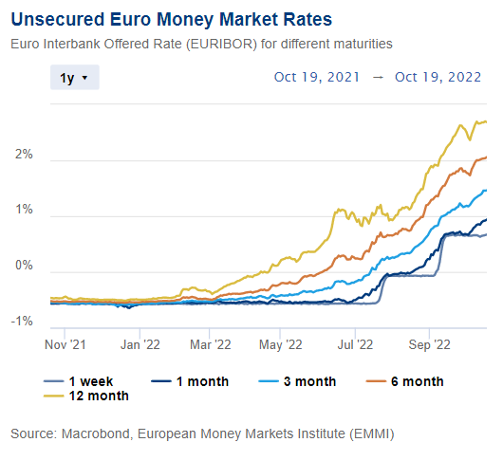
Pass-through works well
(Longer-term) money market rates started to increase already at the beginning of 2022
(due to expectations)
Between January and October 2022 the
3M-Euribor increased by app. 200 basis points
(also due to expectations)
Financial markets expect monetary policy rates to increase to around 2.5% in 2023
Borrowers are already feeling the effects of policy tightening: retail loan rates for corporations (loans up to 1 Mio EUR) increased by more than 100 basis points
Also long-term bond yields (although driven by other forces as well) are on the rise

Slide 11
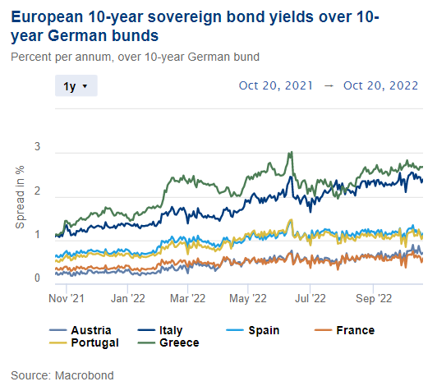
The problem of fragmentation in times of monetary policy normalization
The process of normalization in monetary policy harbors fragmentation risk → unjustified and disorderly market dynamics, especially for (long-term) government bonds in the euro area → threat to the singleness of monetary policy
Transmission Protection Instrument: necessary to support the effective transmission of monetary policy
Criteria: sound and sustainable fiscal and macroeconomic policies
Activation: based on a comprehensive assessment of market and transmission
indicators
decision taken by the ECB Governing Council
Size: Purchases are not restricted ex ante

Slide 12
Looking into the more distant future
Currently, principal payments from maturing securities (in APP & PEPP) are reinvested → this part of Eurosystem’s balance sheet is kept constant
Reducing Eurosystem’s balance sheet via stopping reinvestments or asset sales is currently not an issue
Balance sheet size due to TLTROs III is shrinking: starting in September 2022, each quarter one TLTRO is maturing – moreover, banks can repay TLTROs voluntarily
The marginal monetary policy tool are policy rates, which work very well in a floor system with excess-liquidity conditions
assets
QE
tapering
TLTROs
mature
Reinvest-ments
QE
QT
no reinvestments or sales ?
time

