Slide 1
A Brave New World? The Future of Banking in Emerging Europe Rethinking Size, Structure, Ownership, Policies and Incentives
EU conditionality and commitment to reforms
Vassilis Monastiriotis
European Institute and LSE Research on Southeast Europe
London School of Economics
v.monastiriotis@lse.ac.uk
Joint Bank of Albania and LSE conference 10-11 October 2019, Bank of Albania, Tirana

Slide 2
Starting premise
Changing economic context
post-crisis, resilience, vulnerabilities/exposure, ‘trade-wars’
Changing political context
democratic backsliding, populism, ‘revenge of places that don’t matter’
Changing geo-politics
Russia / China influence, Brexit, ‘accession freeze’
Changing policy objectives
permanent reforms, quality of institutions, functioning market economy, pre-accession
What explains slow progress with transition / accession / reforms?
(EBRD/IMF: ‘deceleration of reforms’)

Slide 3
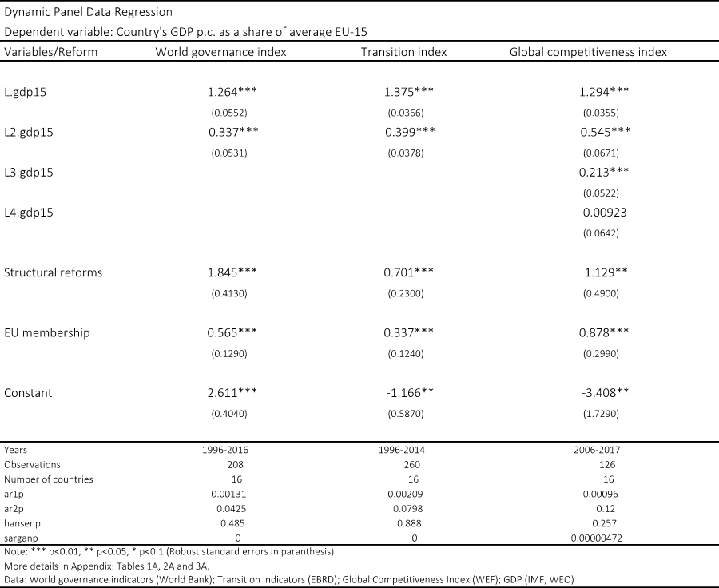
Institutions and EU-induced growth
Table. The impact of structural indicators on convergence

Slide 4
Lit on reforms and conditionality
Political economy of reforms
Delays/non-compliance associated with types of political market failures
Corruption and capture (Innes, 2014); institutional quality (Acemoglu et al., 2005); distributive politics (Alesina and Rodrik, 1994); or even pure information and coordination problems (e.g., time-inconsistency – Kydland and Prescott, 1977; or status-quo bias – Fernandez and Rodrik, 1991)
PE of the Balkans
Emphasises is instead on problems of external policy design (misfit, inconsistency) and problems of domestic compliance (Dzankic, 2019)
Notion of ‘able and willing’ in “new approach” – constraints & preferences?
This analysis
An analytical model incorporating EU anchor (PE of EU/Balkans) and reform delays / reform resistance (status-quo bias / PE of reforms)

Slide 5
Model set-up
The government
Reform-neutral government, with pro-accession preferences (no utility from reforms, unless linked to EU – e.g., accession)
Agrees EU reforms (r_{EU}), experiences loss if over/under-shooting
Enjoys public support around a ‘natural’ level (s_{N})
α₁: intensity of govt’s attention to accession (how much it ‘values the EU’)
α₂: intensity of govt’s attention to public support (degree of ‘populism’??)
The government wants to set r=r_{EU} and s=s_{N} (or, s=s^{max})

Slide 6
Model set-up
The public
Public pro-EU but negative utility from reforms (else, trivial: infinite reforms)
β₁: intensity of public’s preference (“bias”) for status quo (disutility from reforms)
β₂: how public values accession (disutility from government missing the EU target)
In the absence of the EU, the public prefers r=r_{SQ} => s=s_{N}
We treat the EU (its ‘desired’ level of reforms) as exogenous

Slide 7
Equilibrium
Solution
Incorporate constraint into welfare loss function
Differentiate wrt reforms (r), set equal to zero and solve for r
with
The level of reforms is a weighted average of the status quo and the EU-driven reform target
Thus the optimal policy choice for the government is to ‘defect’
For any case of EU pre-accession negotiations (i.e., for every r_{EU}>r_{SQ}), no government has an incentive to comply fully with the agreed targets: defection / lack of commitment is an endogenously emerging equilibrium outcome

Slide 8
Equilibrium
Implications
The optimal policy choice for the government is to ‘defect’ (deliver reforms below the level agreed with the EU)
In equilibrium, the level of reforms will
increase with α₁ and β₂ (weights assigned to accession by govt and public)
decline with α₂ and β₁ (the govt’s weight to public support and the intensity by which the public dislikes reforms above the status quo)
The extent of ‘defection’ will be greater (by a factor of θ), the more ‘aggressive’ the EU is in setting the reform target with the government: $\left(r_{EU}−r\right)=θ(r_{EU}−r_{SQ})$
the government will appear to lack credible commitment by more the higher the distance between the status quo and the EU target

Slide 9
A visual depiction
Interests (I)
Reforms under EU negotiations
Domestic preferences
EU ‘desired’ level of reforms
I_{C}
Shift preferences (govt)
Change capabilities (public)
Change target (EU)
Note de facto favouring of pro-reform govts and ‘high capacity’ (low SQ-bias) publics
I_{EU}
Implementation gap
R_{C}
R_{EU}
Reforms (R)

Slide 10
What the EU can do
Policy options
Increase α₁ – e.g., via socialisation
But this will not achieve full compliance; it will simply reduce the discrepancy of r from r_{EU}
Reduce α₂ – e.g., via elite influence
As above, this will only reduce, rather than eliminate, the discrepancy between r and r_{EU}
But note: making the govt less responsive to the public is politically undesirable
Reduce β₁ – e.g., via yardstick and information-sharing
But note: too much ‘intrusion’ may backfire / create anti-EU sentiment; and ‘learning’ is a long-term process
Increase β₂ – e.g., via better communication and education
Long-term goal of ‘demonstrating’ the benefits from accession (incl non-pecuniary ones)

Slide 11
What the EU can do
Comparative statics (I)
Status quo bias vs government preferences for EU accession
When status quo bias is very high, it pays for emphasis to be placed on altering the preferences of the govt (raising α₁ instead of focusing on β₁)
But this will not achieve full compliance; it will simply reduce the discrepancy of r from r_{EU}
Govt prefs for public support vs public prefs for EU accession
When govts are too ‘populist’ (high α₂ and low α₁), attention to changing public attitudes towards the EU (raising β₂) may be most appropriate
→ But this may create frictions with domestic governments / managing opposition

Slide 12
What the EU can do
Comparative statics (II)
Public attitudes to EU accession and status quo
Concerning public attitudes, policy should focus on the least intense of these: when the public feels more strongly about the status quo, policy should try to influence (favourably) the public’s attitudes towards the EU
This is rather counter-intuitive, but perhaps an ‘easy’ policy target for the EU
Government attitudes to EU accession and public support
When the public’s emphasis on EU accession is VERY low, reform gaps can be reduced more effectively by raising the govt’s emphasis on accession than by focusing on reducing the govt’s attention to public support; else, emphasis should be on reducing the attention govts pay to public support rather than on raising their preferences towards EU accession
This is inherently problematic, raising concerns about democratic legitimacy

Slide 13
Conclusions
Reform effort has subsided / is difficult to maintain, even though it is known that reforms raise growth and speed-up accession
The main message of the analysis presented here is that non-compliance is endogenous to the (pre-)accession process
In line with literature, here the effectiveness of conditionality is hindered by the EU setting too high / unrealistic targets: reduce the extent of non-compliance by lowering the EU reform target
Thus, a trade-off in maximising reform effort vs compliance
Effort: clear economic benefits (at least in LR) and can help speed up accession
Compliance: reputational and wider political benefits (e.g., with regard to public perceptions about the legitimacy and effectiveness of EU conditionality)

Slide 14
A Brave New World? The Future of Banking in Emerging Europe Rethinking Size, Structure, Ownership, Policies and Incentives
EU conditionality and commitment to reforms
Thank you!
Email: v.monastiriotis@lse.ac.uk
Joint Bank of Albania and LSE conference 10-11 October 2019, Bank of Albania, Tirana

