Slide 1
A Green Finance Gap in Emerging Europe?
Ralph De Haas (EBRD and LSE-IGA)
Bank of Albania–LSE IGA Conference “A Brave New World? The Future of Banking in Emerging Europe”
October 11th, 2019
The usual disclaimer applies

Slide 2
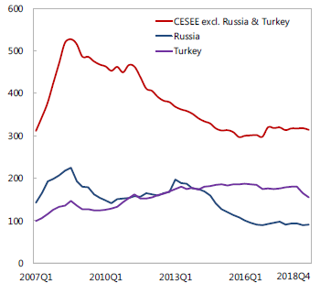
A decade of bank deleveraging in CESEE…
External position of BIS-reporting banks
https://www.aeaweb.org/articles?id=10.1257/app.20130170
Source: Vienna Initiative CESEE Deleveraging and Credit Monitor, May 2019

Slide 3
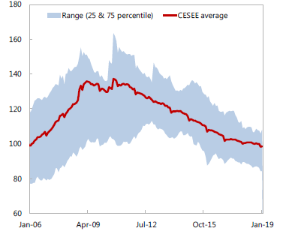
A decade of bank deleveraging in CESEE…
External position of BIS-reporting banks
Loan to domestic deposit ratio
https://www.aeaweb.org/articles?id=10.1257/app.20130170
Source: Vienna Initiative CESEE Deleveraging and Credit Monitor, May 2019

Slide 4
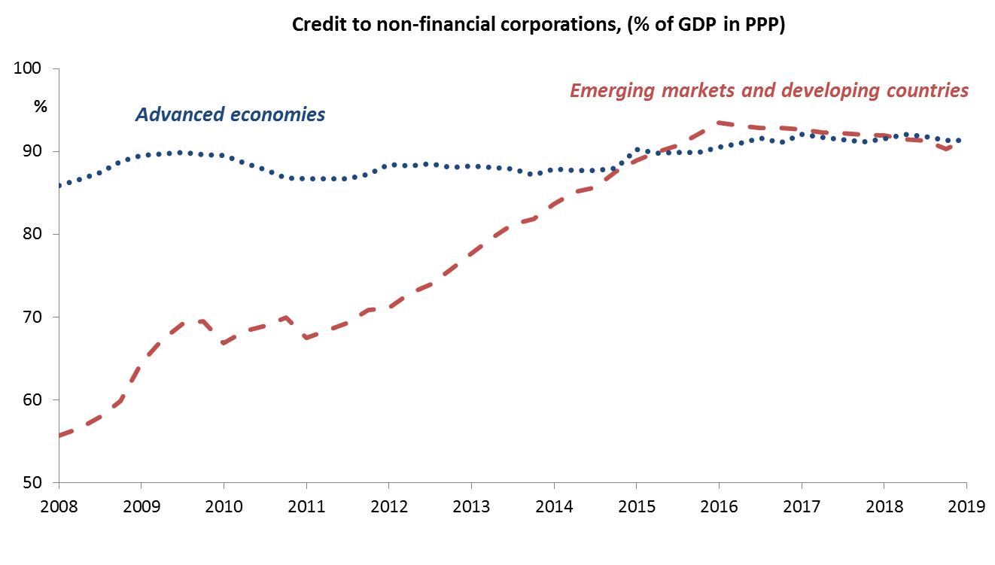
… but a decade of credit expansion elsewhere
https://www.aeaweb.org/articles?id=10.1257/app.20130170
Source: BIS and authors’ calculations.
Notes:
Emerging markets in general: Increase in corporate credit from 55% to 95% of GDP over the past decade
Short term: FX risk, NPLs, shortening maturities etc.

Slide 5
Are banks best placed to finance CESEE growth?
Looking back
By and large, banks have done a formidable job in helping CESEE catch up…
… by helping firms to adopt foreign technologies and increase productivity

Slide 6
Are banks best placed to finance CESEE growth?
Looking back
By and large, banks have done a formidable job in helping CESEE catch up…
… by helping firms to adopt foreign technologies and increase productivity
Looking forward
Banks’ track-record in financing frontier innovation is less impressive…
… while their role in financing green growth is so far underwhelming too

Slide 7
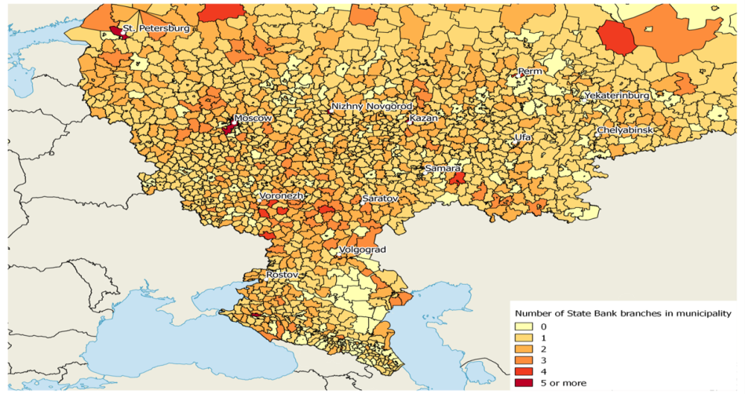
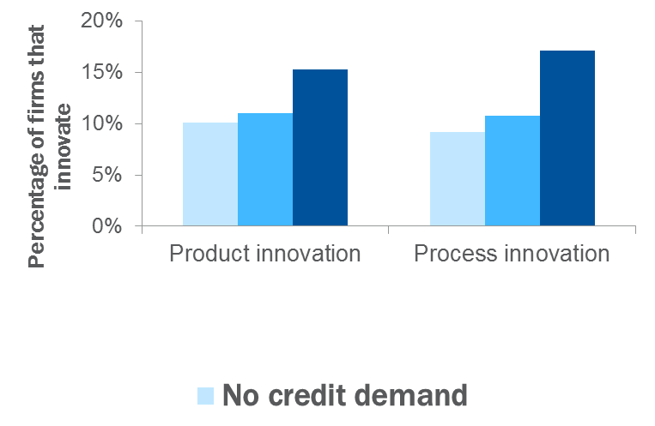
Micro evidence: Limits to the economic impact of bank lending
Access to bank credit helps small businesses to reap the low-hanging fruits of imitative and adaptive innovation, but…
…is less successful in promoting frontier innovation and new patent applications
Sources: Plekhanov and Stostad (2018).
Source: Bircan, C. and R. De Haas (2019), The limits of lending? Banks and technology adoption across Russia, Review of Financial Studies, forthcoming.
Notes:
High-tech industries innovate more (less) in countries with deeper stock (credit) markets
Stock but not credit market development boosts R&D

Slide 8
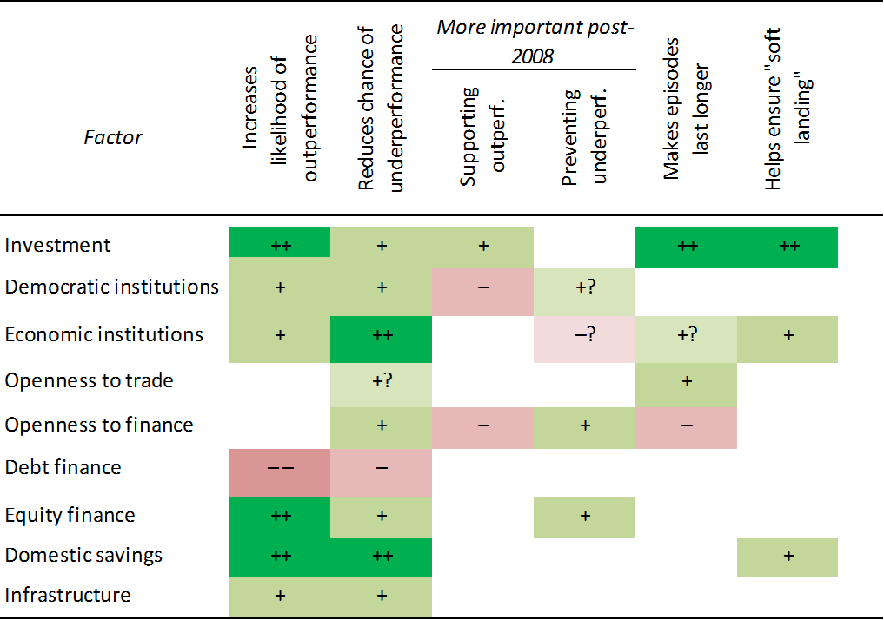
Macro evidence: Limits to the economic impact of bank lending
Correlates of growth outperformance episodes, a summary view
Sources: Plekhanov and Stostad (2018).
Source: Plekhanov and Stostad (2017)

Slide 9
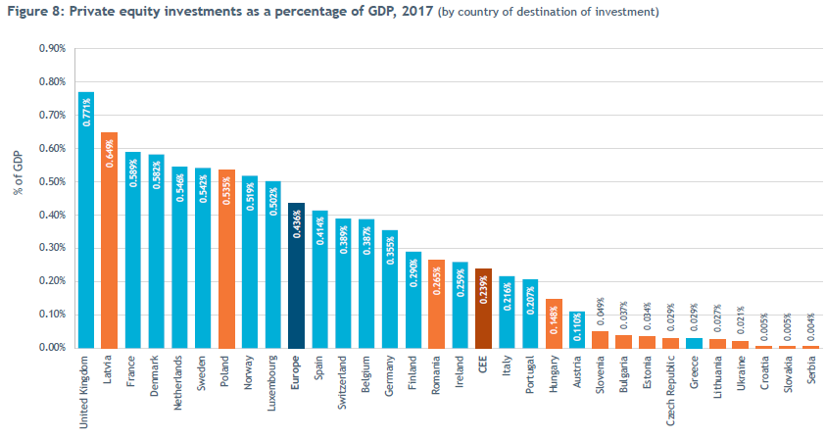
Equity culture remains underdeveloped in CESEE…
Source: InvestEurope
Notes:
Invest Europe – online (https://www.investeurope.eu/media/727455/Invest-Europe-CEE-Activity-Report-2017-05072018.pdf )

Slide 10
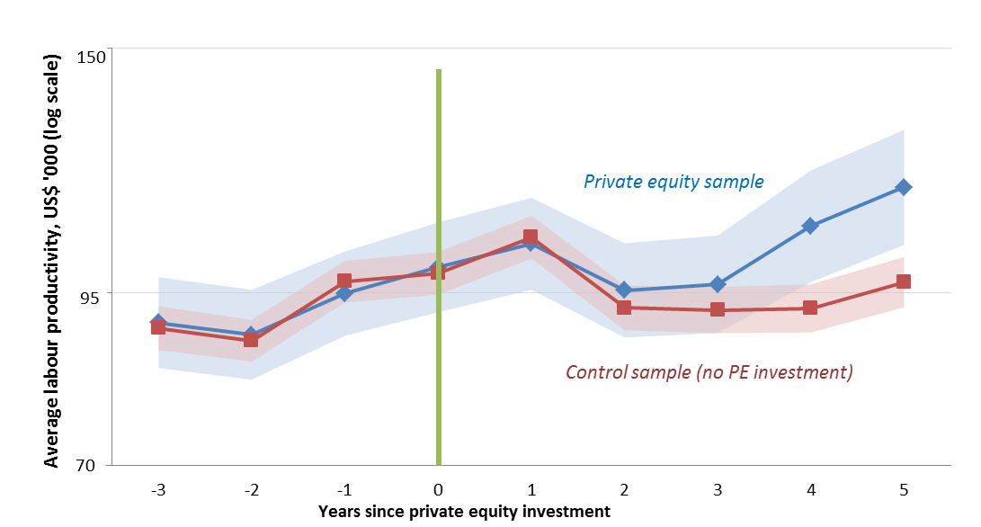
… even though PE can have large positive impacts on labour productivity, profitability, and job creation
Sources: EBRD, Orbis and authors’ calculations
Notes:
High impact: PE investment on average adds 30 jobs within 5 years. Increases labour productivity and profitability

Slide 11
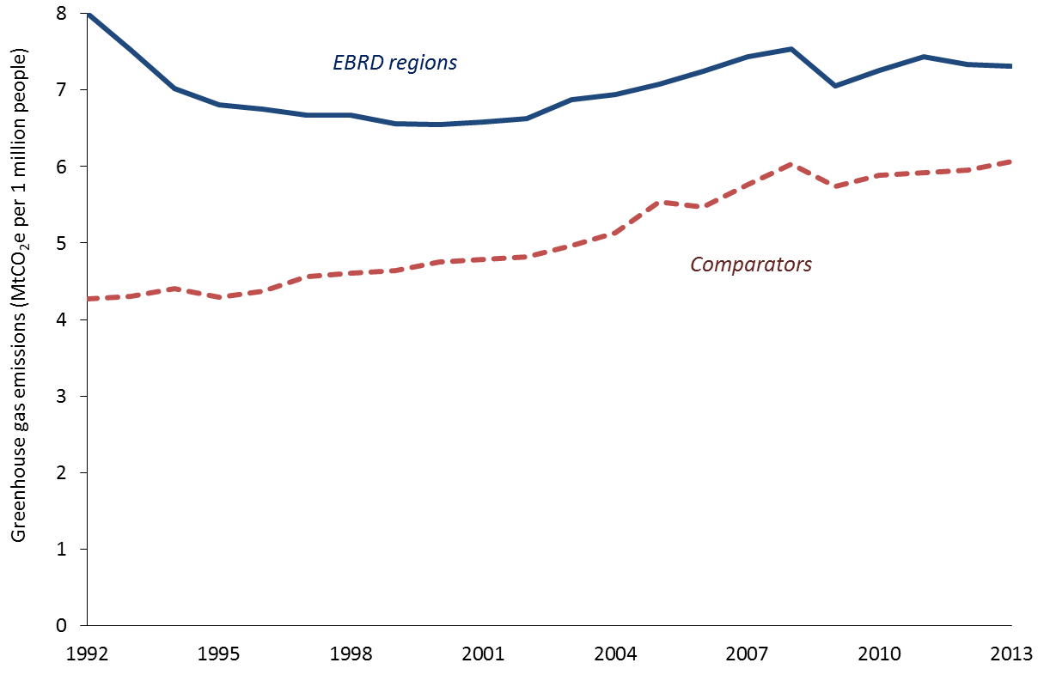
Equity financing may also facilitate the green transition
Greenhouse gas emissions per capita
Sources: World Resources Institute (2017) and authors’ calculations.

Slide 12
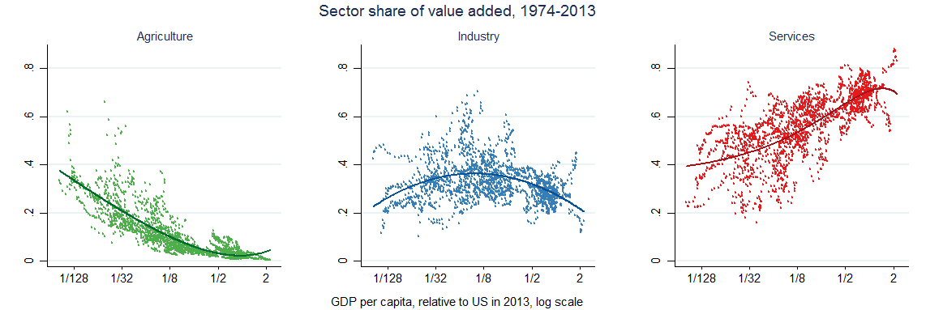
Equity financing may also facilitate the green transition
Strong but opposite effects of credit and stock markets on industrial pollution:
CO₂ emissions increase with credit market, and decline with stock market, development
Credit-market effect is driven by cross-sectoral reallocation
Stock-market effect is driven by an improvement in within-sectoral energy efficiency
Source: De Haas, R. and A. Popov (2019), Finance and Carbon Emissions, CEPR Discussion Paper DP 14012.

Slide 13
To wrap up
Banks were an impressive convergence motor in CESEE during the first two decades of transition
For sustained and sustainable growth in CESEE, financial systems need to rebalance: less credit and more equity
Easier said than done…
Improve legal protection of minority investors (e.g. allow them to exercise rights to appoint board members)
Limit tax-code favouritism towards debt (as Belgium did in 2006)
ALSE: right intentions but viable? Alternatives: Albanian market segment at a regional exchange or regional order-routing platform such as SEE Link

