Slide 1
A changing environment – Implications for our economies and for the financial system Bank of Albania & LSE conference, ”A Brave New World? The Future of Banking in Emerging Europe”, October 11, 2019
Marianne Nessén Senior advisor to the Executive Board
The views expressed here are my own and do not necessarily reflect those of the Executive Board of Sveriges Riksbank

Slide 2
A changing environment for our economies and the financial system
Low interest rates
Transformative new technologies
Risks from climate change

Slide 3
Interest rates have fallen, globally and for a long time
Sweden
Germany
Note: Zero-coupon rates for Sweden and Germany from government bonds. Ten year benchmark for US.
Sources: Deutsche Bundesbank, Federal Reserve and the Riksbank
Notes:
Daglig data.

Slide 4
Real interest have been negative before
Note: 10-year government bond rate minus inflation
Sources: Bank of England, European Central Bank, Federal Reserve and Riksbank
Notes:
Månadsdata. (Finns även årsdata om önskas).

Slide 5
Yield curves have flattened German bunds

Slide 6
Cost-to-income ratio Swedish and other European banks
Note. Swedish large banks: SEB, SHB, Swedbank. Large banks in Sweden: Swedish banks + Nordea and Danske bank. European banks: Peer group of 15 European banks.
Source: SNL and the Riksbank

Slide 7
Transformative technological changes
”Fin Tech credit: Online lending plattforms in Sweden and beyond” by Christoph Bertsch and Carl-Johan Rosenvinge, Sveriges Riksbank Economic Review no. 2
(available on www.riksbank.se)

Slide 8
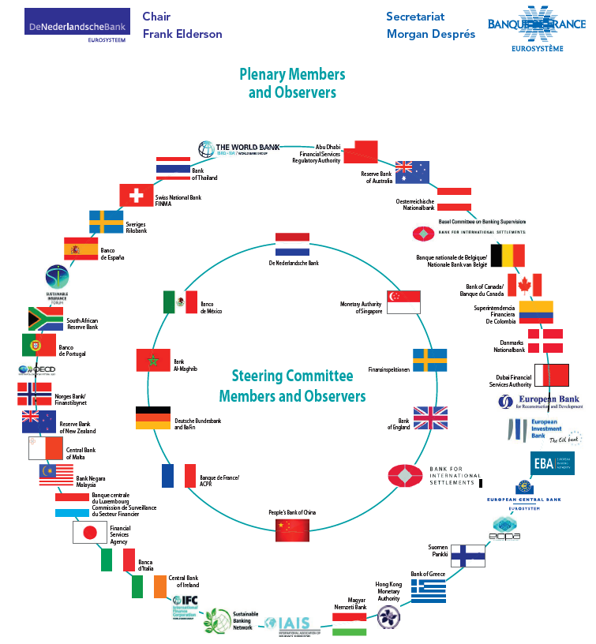
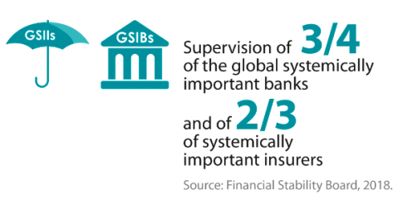
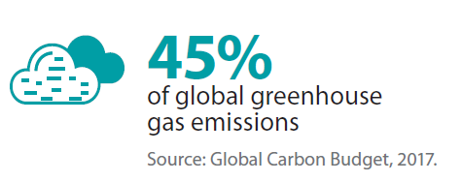
NGFS: GROWING MEMBERSHIP (as of end-July 2019)

Slide 9
NGFS: AN ANSWER TO CLIMATE URGENCY
Climate change source of structural change in the economy/financial system with a number of specificities:
Far-reaching impact in breadth and magnitude
Foreseeable nature
Irreversibility
Dependency on short-term actions for medium/long term impacts
Non linearity and tipping points
Climate-related risks are a source of financial risk. It is therefore within the mandates of central banks and supervisors to ensure the financial system is resilient to these risks
Highly likely that climate-risks are not properly reflected in asset valuations

Slide 10
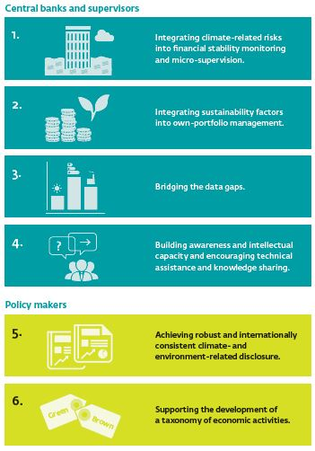
NGFS: 6 RECOMMENDATIONS

