Slide 1
The inflation comeback: Global sources, local therapies
Bank of Albania / LSE conference
October 27
Eduardo levy Yeyati, UTDT

Slide 2
Latin America’s trilemma
Macroeconomic: Adjust to contain inflation & reduce fiscal deficits and indebtedness.
Social: Improve social indicators after years of subpar growth and rising poverty and inequality.
Political: Rebuild the social contract to revert the discontent with liberal democracy and the mistrust in the political system.

Slide 3
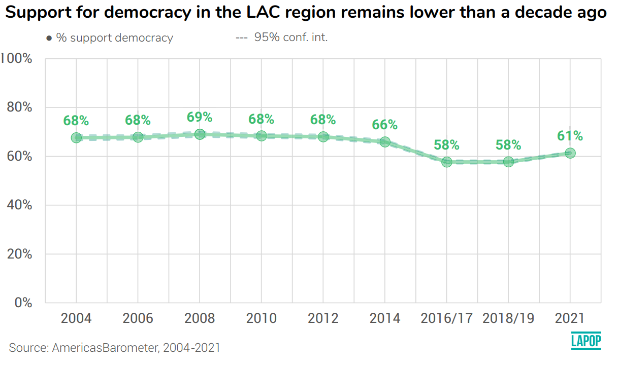
Visto de otro modo

Slide 4
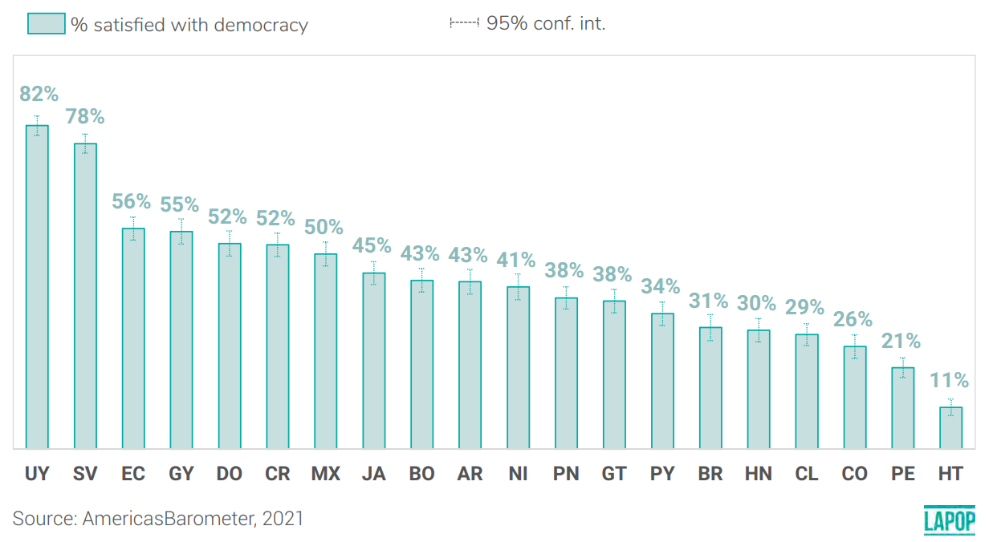

Slide 5
Inflation: The litmus test
The demand side:
Fiscal stimuli (the pandemic transfers financed by money issuance or debt).
Central bank passivity (persistence of liquidity conditions that brought rates to historic lows).
Complacency (spend now, bring the receipts later) → r < g

Slide 8
Inflation: The litmus test
The supply side:
Supply chain disruptions and rearrangements in GVC that created input supply deficits and higher prices for goods and services.
Labor shortages due to long covid, greater quit rates, weaker participation and labor supply changes that are still unclear.
Greater sensitivity to imported inflation: Impact of Russia's invasion of Ukraine on prices of food, energy and fertilizers.
GFC: pass-through of dollar strength to prices (the flipside of the US)
Inflation inertia (rents in the US, partial wage indexation in Chile or Uruguay, de-anchoring of expectations, etc.)

Slide 9
Unbalanced macro policies
Demand shocks are typically addressed with a mix of fiscal and monetary policies, but…
…in countries coming from years of growth underperformance, social unrest, and weakening political representation limit the social and political space for fiscal consolidation → The main burden falls on the central banks.
Monetary overtightening and fiscal under-adjusting.

Slide 10
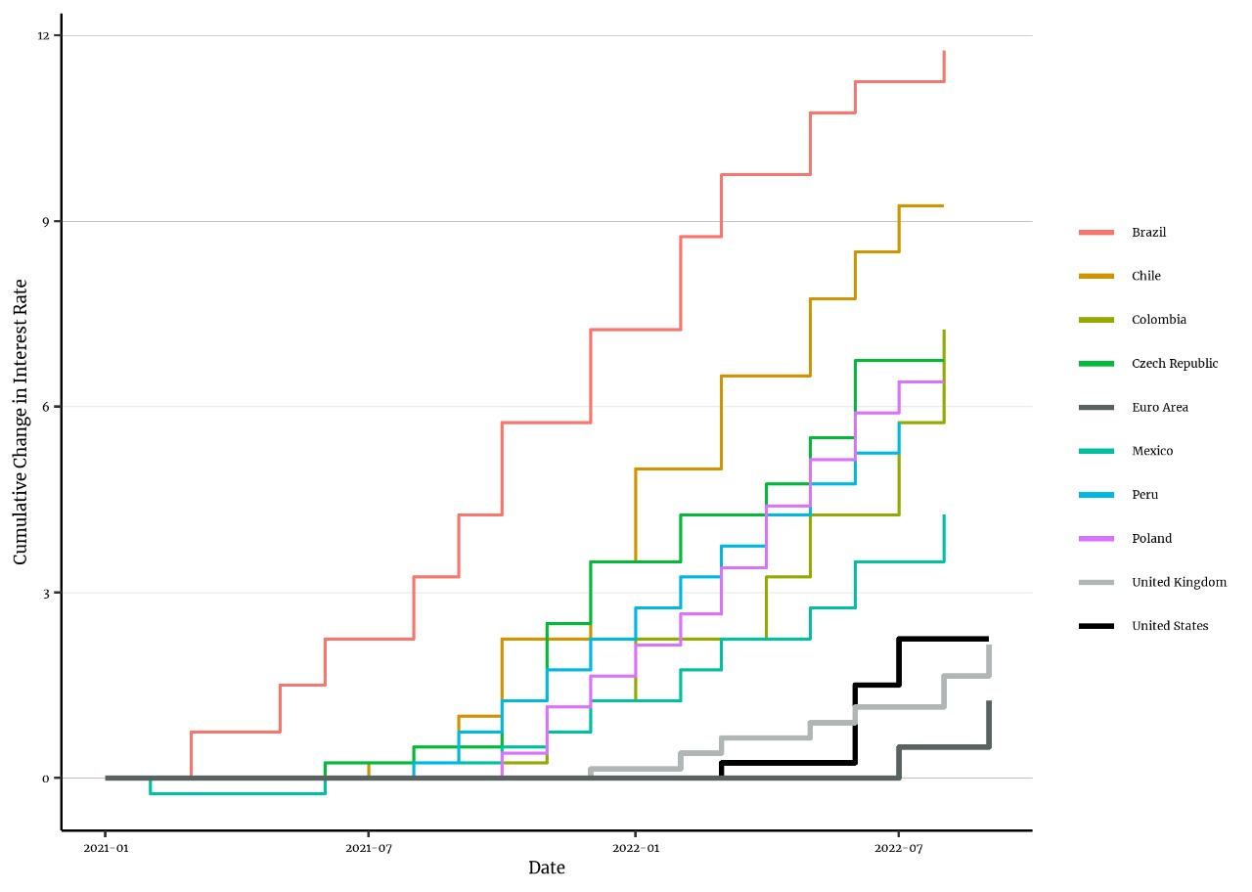

Slide 11
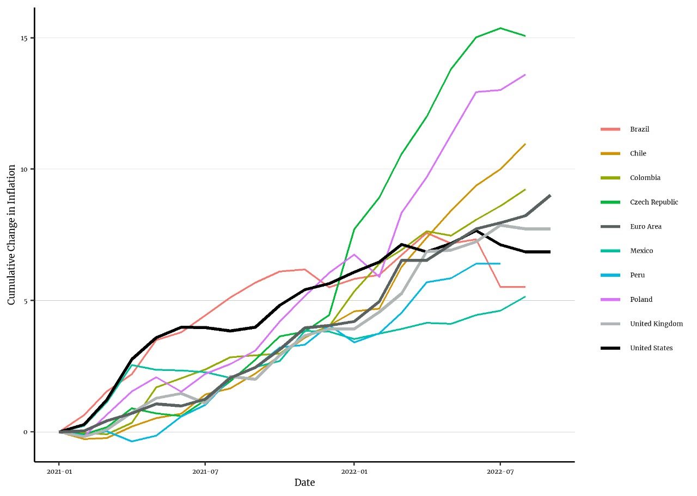
EM CBs started earlier

Slide 12
Inflation, rates & fiscal balance

Slide 13
Persistent supply shocks
The policy response to the multiple supply shocks is more problematic
Macro policy is ill-designed to address them.
Structural adjustments require time.
Food subsidies and energy caps are limited by the lack of fiscal space.
Even the appreciation card (better ToT for in the case of commodity exporters & monetary tightening in general) is ruled out by the dollar strength.
Is that why the early movers are not getting much in return?

Slide 15
The inflation comeback: Global sources, local therapies
Bank of Albania / LSE conference
October 27
Eduardo levy Yeyati, UTDT

