Slide 1
Energy transition, climate change and monetary policy
Előd TAKÁTS | Flora BUDIANTO
Inflation is back: how to deal with it under heightened uncertainties
Bank of Albania – London School of Economics conference
Tirana | 26-27 October 2022
This presentation reflects the views of its authors, not necessarily the views of the Corvinus University of Budapest or the Vienna University of Technology

Slide 2
Motivation
Energy transition is critical
  Russian gas/oil European renewables
  Brown energy (eg coal) green energy (eg solar)
Explicit or implicit tax drives energy transiton (eg carbon tax, sanctions)
Key observation: The only way is forward, we need (green) innovation
  We need to develop endogenously new green technologies
Question: should central banks change monetary policy in response to energy transition challenges?
  eg weight on inflation

Slide 3
Results
Question: should central banks change monetary policy in response to energy transition challenges?
  eg. weight on inflation
Framework: Monetary policy within central banks mandates
  Economic stability (inflation-output trade-off)
We answer this question by combining three elements
  We investigate the green energy transition induced by a (carbon) tax
  We model (green) innovation following (Anzoategui et al, 2019, AEJ Macro)
  In the standard Smets and Wouters (2007) monetary model focusing on economic stability
More dovish monetary policy might improve welfare and speed up green transition

Slide 4
Intuition
Green innovation model
  You need to develop new, green energy sources
  You develop green energy faster, if (energy) demand is stronger
Carbon tax is a contractionary supply shock that
  Depresses use of brown energy directly through price effects
  But by depressing the economy, it also depresses green energy demand, and thereby green innovation indirectly
Monetary policy can speed up the transition by more dovish policies than standard
  Letting inflation run higher preserves demand
  Higher output is not only useful for current consumption (as in the standard setup), but also fostering energy demand
  Thus, there is a new additional reason for more accommodating monetary policy
  [Stronger price rigidities imply stronger role for monetary policy]

Slide 5
Roadmap
Motivation and intuition
Model
  Green and brown energy sectors and R&D sector as in Comin and Gertler (2006) and Anzoategui, Comin, Gertler and Martinez (2019, AEJ Macro)
  Incorporated into a medium-scale DSGE model as in Smets and Wouters (2007)
Results
Extensions
Conclusion

Slide 6
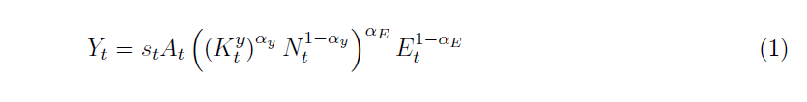
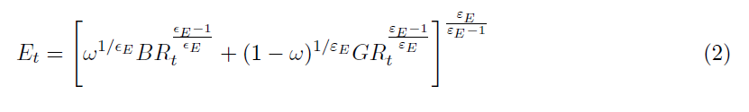
Energy sector
Consumption goods are produced using capital, labor and energy:
In the energy sector, energy is produced from green energy and brown energy intermediates:
Brown and green intermediates are imperfect substitutes (ie. transition to greener energy mix is costly). Profit maximization yields the demand functions:

Slide 7
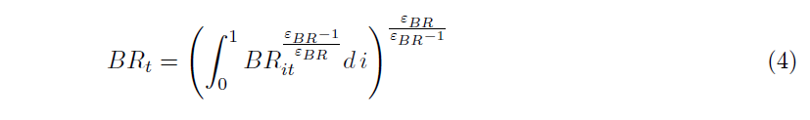

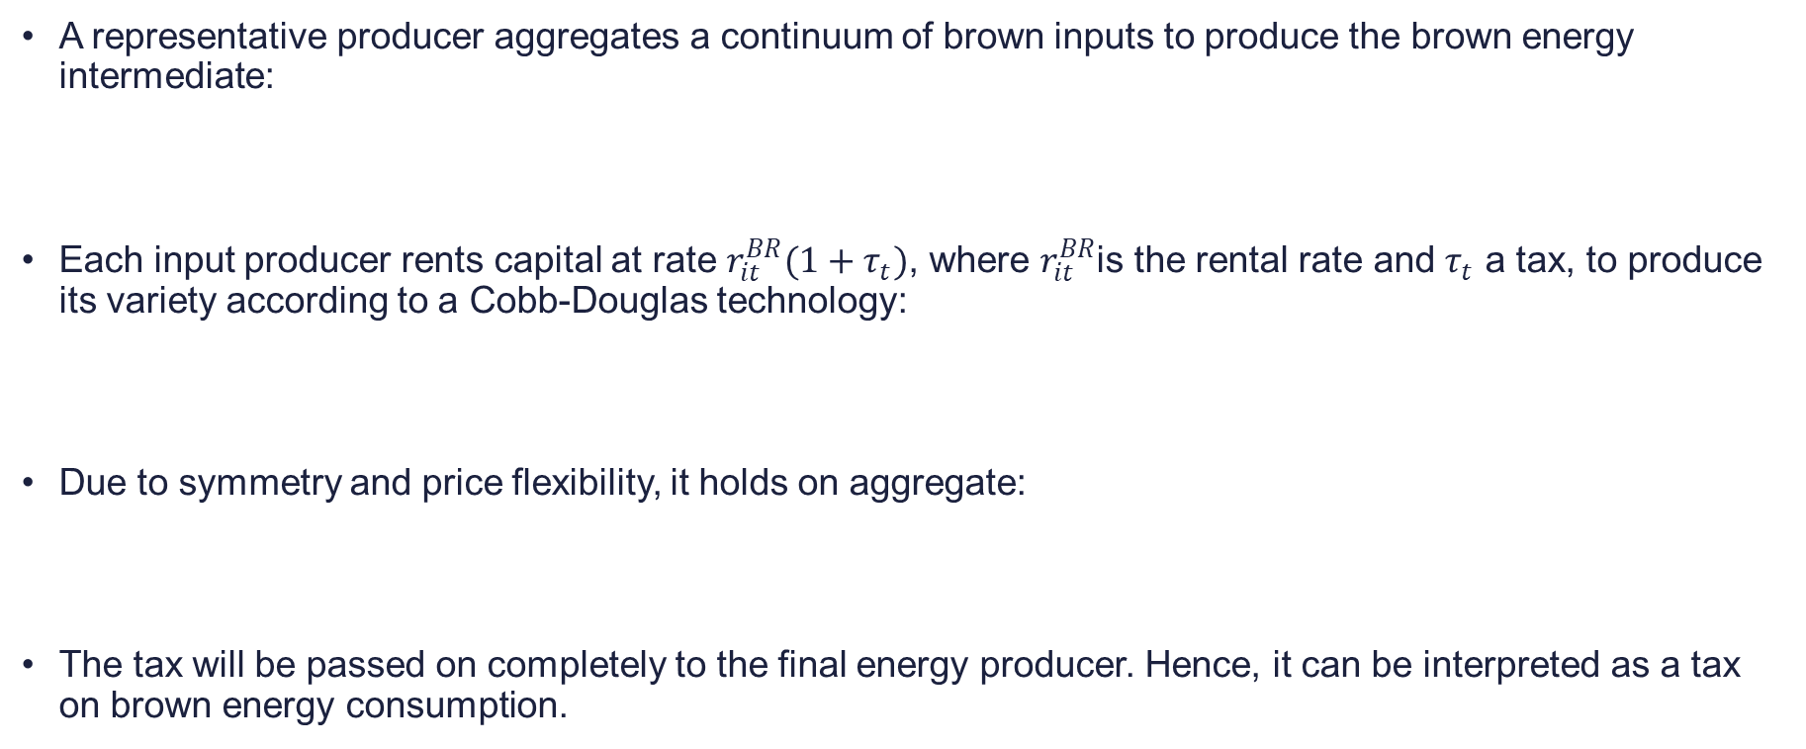
The brown energy sub-sector
A representative producer aggregates a continuum of brown inputs to produce the brown energy intermediate:
Each input producer rents capital at rate $r_{it}^{BR}(1+τ_{t})$, where $r_{it}^{BR}$is the rental rate and $τ_{t}$ a tax, to produce its variety according to a Cobb-Douglas technology:
Due to symmetry and price flexibility, it holds on aggregate:
The tax will be passed on completely to the final energy producer. Hence, it can be interpreted as a tax on brown energy consumption.

Slide 8
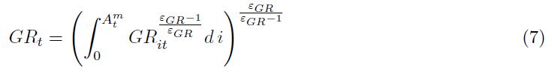
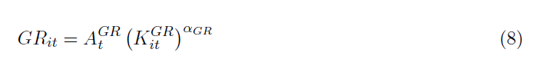
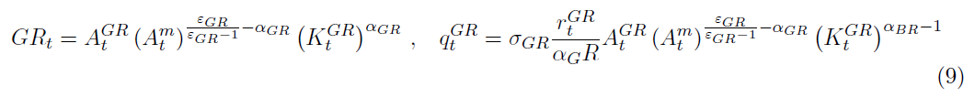
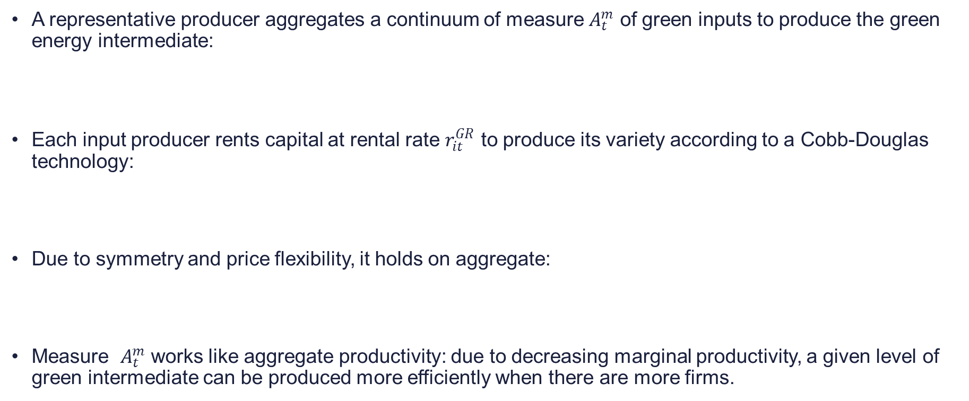
The green energy sub-sector
A representative producer aggregates a continuum of measure $A_{t}^{m}$ of green inputs to produce the green energy intermediate:
Each input producer rents capital at rental rate $r_{it}^{GR}$ to produce its variety according to a Cobb-Douglas technology:
Due to symmetry and price flexibility, it holds on aggregate:
Measure $A_{t}^{m}$ works like aggregate productivity: due to decreasing marginal productivity, a given level of green intermediate can be produced more efficiently when there are more firms.

Slide 9

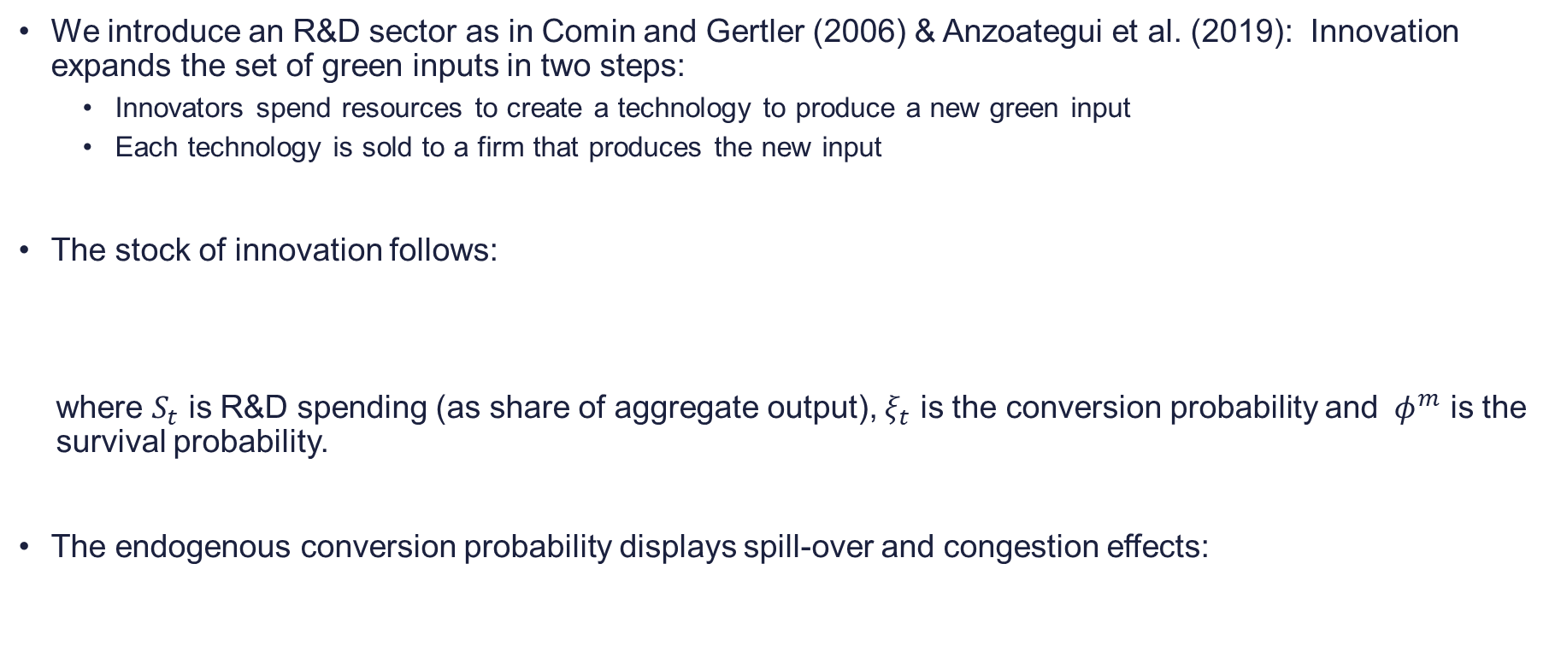
Green innovation
We introduce an R&D sector as in Comin and Gertler (2006) & Anzoategui et al. (2019): Innovation expands the set of green inputs in two steps:
  Innovators spend resources to create a technology to produce a new green input
  Each technology is sold to a firm that produces the new input
The stock of innovation follows:
where $S_{t}$ is R&D spending (as share of aggregate output), $ξ_{t}$ is the conversion probability and ${ φ}^{m}$ is the survival probability.
The endogenous conversion probability displays spill-over and congestion effects:
Notes:
n

Slide 10


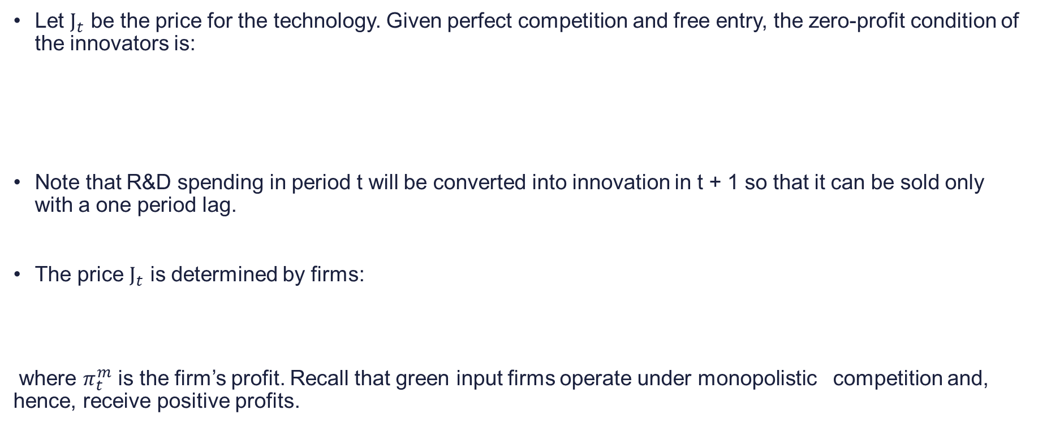
Green innovation
Let $J_{t}$ be the price for the technology. Given perfect competition and free entry, the zero-profit condition of the innovators is:
Note that R&D spending in period t will be converted into innovation in t + 1 so that it can be sold only with a one period lag.
The price $J_{t}$ is determined by firms:
where $π_{t}^{m}$ is the firm’s profit. Recall that green input firms operate under monopolistic competition and, hence, receive positive profits.
Notes:
n

Slide 11

Rest of model: medium-scale DSGE as in Smets and Wouters (2007)
Based on Smets and Wouters (2007):
  Households:
    Representative household maximizes utility from consumption and leisure under complete capital markets.
  Firms:
    Final good production: homogeneous final good, produced with a continuum of imperfectly substitutable intermediate goods
    Intermediate goods production: monopolistically competitive firms produce with capital, labor and energy and face Calvo-price rigidities
  Central bank
    Monetary policy follows a standard Taylor-type rule to stabilize inflation and output
We use standard model parametrization to calibrate

Slide 12
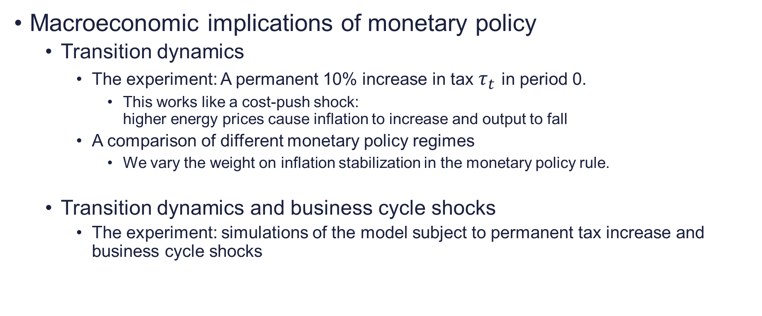
Results
Macroeconomic implications of monetary policy
  Transition dynamics
    The experiment: A permanent 10% increase in tax $τ_{t}$ in period 0.
      This works like a cost-push shock:
      higher energy prices cause inflation to increase and output to fall
    A comparison of different monetary policy regimes
      We vary the weight on inflation stabilization in the monetary policy rule.
  Transition dynamics and business cycle shocks
    The experiment: simulations of the model subject to permanent tax increase and business cycle shocks

Slide 13
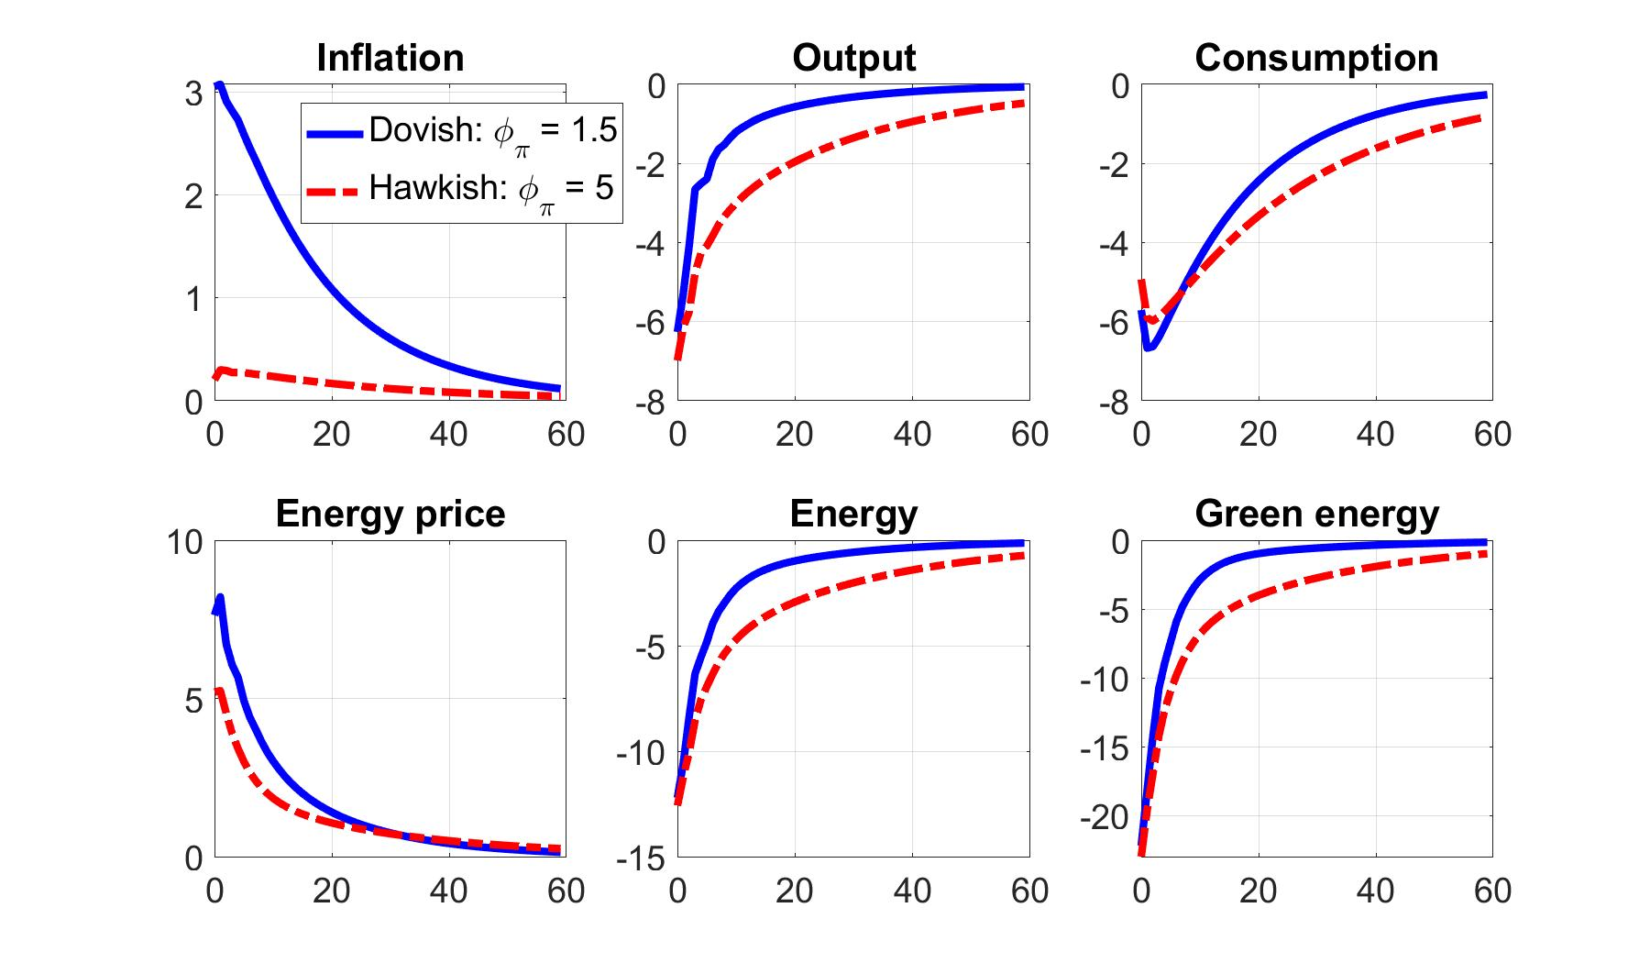
Transition dynamics: macroeconomic implications
More accommodative policy helps to preserve output and energy demand – at the cost of higher inflation.
This fosters investment in green innovation which helps to speed up the transition to a greener energy mix.
Factor reallocation to the green sector requires investment. Hence, households consume less in first periods after carbon tax shock.
Note: inflation has been annualized.

Slide 14
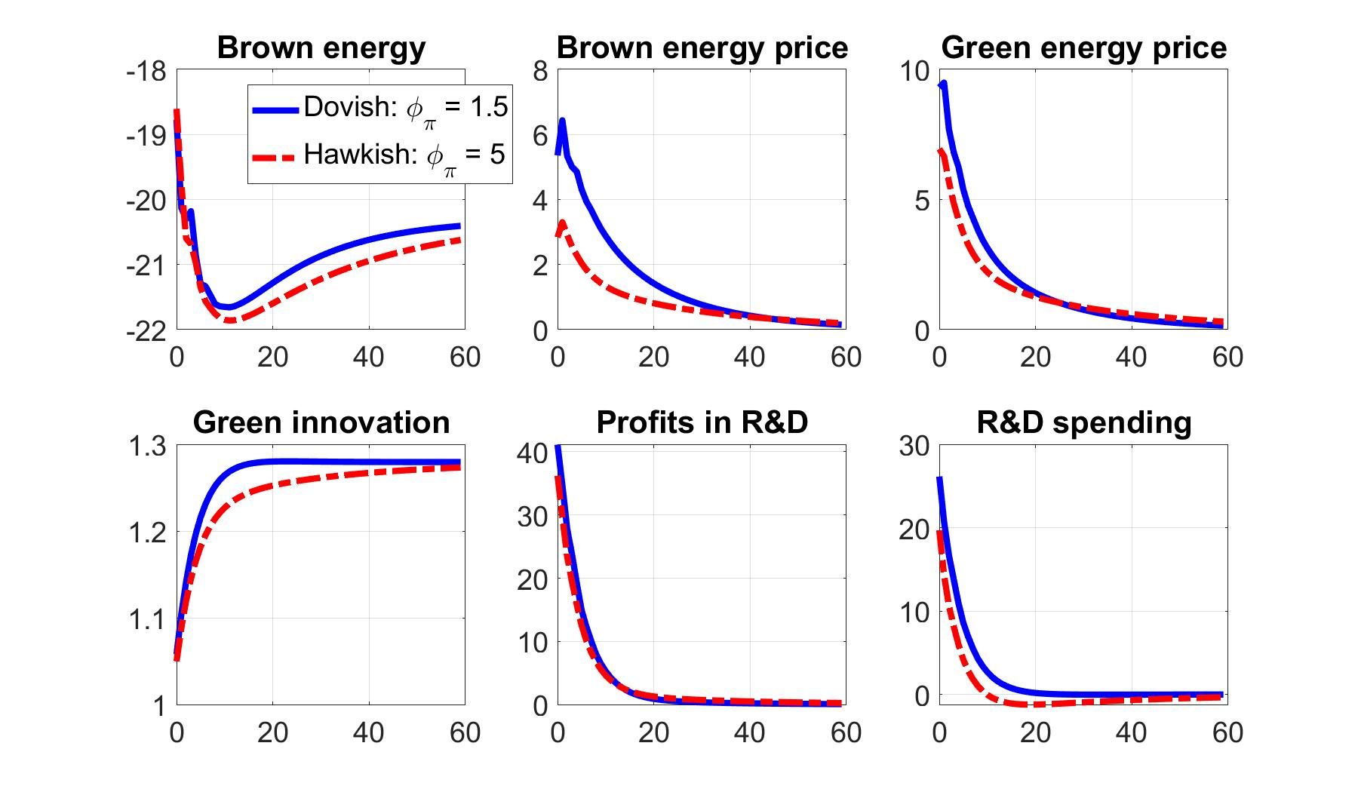
Transition dynamics: energy sector
Accommodative policy pushes up energy prices and profits in the R&D sector.
Innovation in the green sector raises to a permanently higher level.

Slide 15
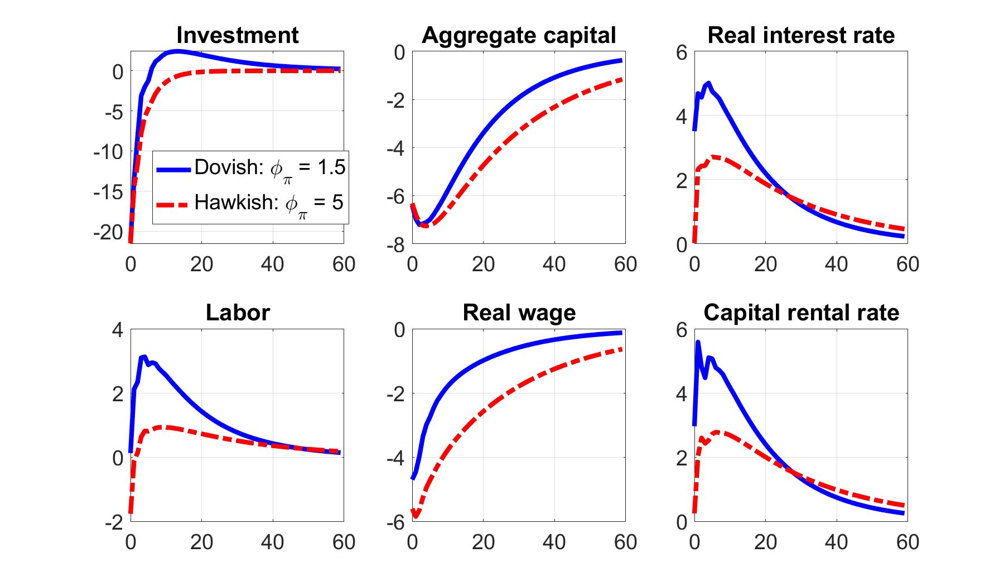
Transition dynamics: investment and capital
Under the accommodative policy, the real interest rate rises first but then falls, consistent with investment/ consumption dynamics.
Note: the real interest rate has been annualized.

Slide 16
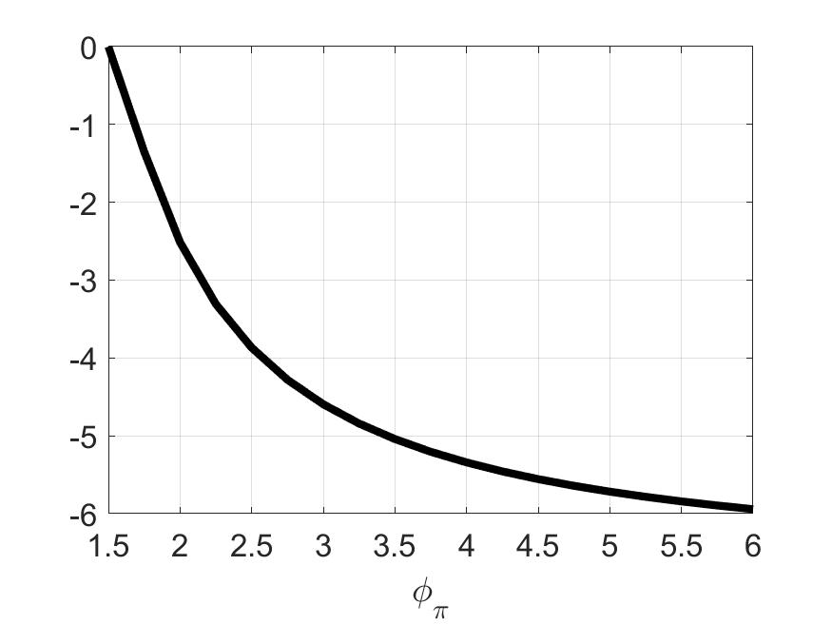
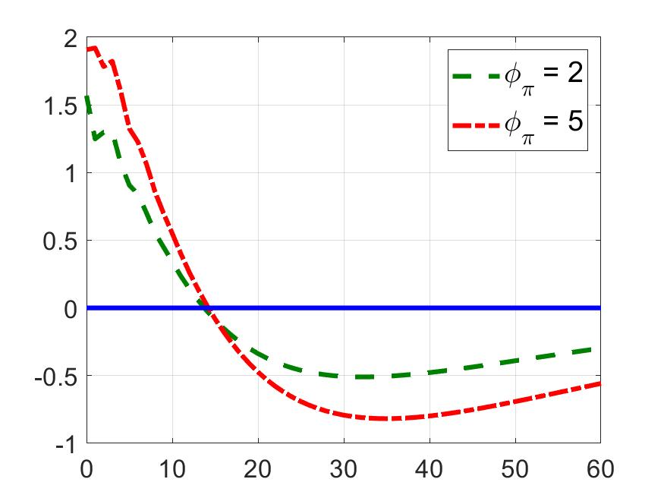
Welfare under different monetary policy strategies
We compute consumption equivalents: how much (in terms of st.st. consumption) is the household willing to give up to stay with the accommodative policy ($φ_{π}=1.5$)?
Present value of consumption-equivalent loss
Period-by-period consumption-equivalent losses and gains

Slide 17
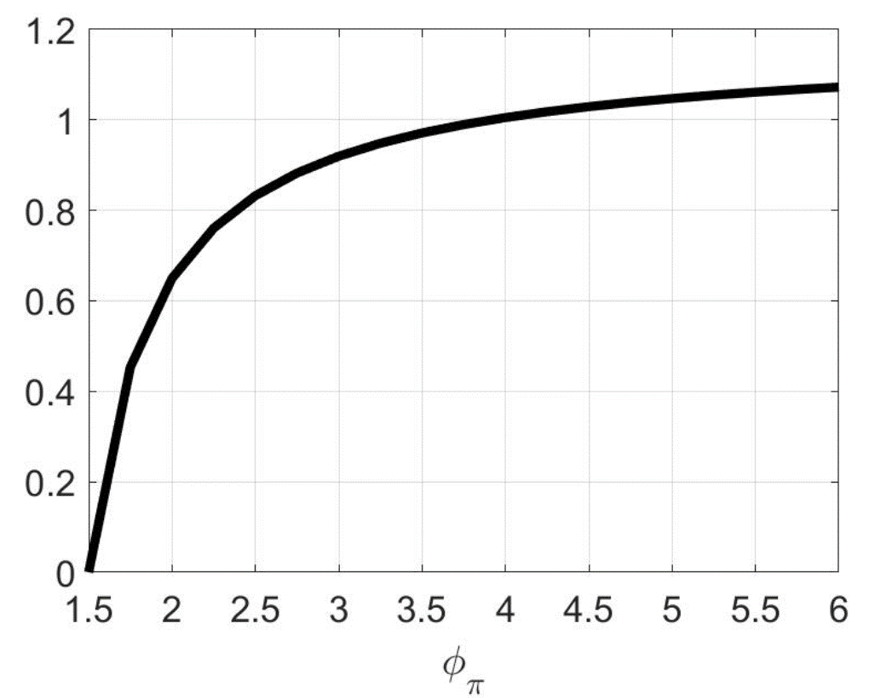
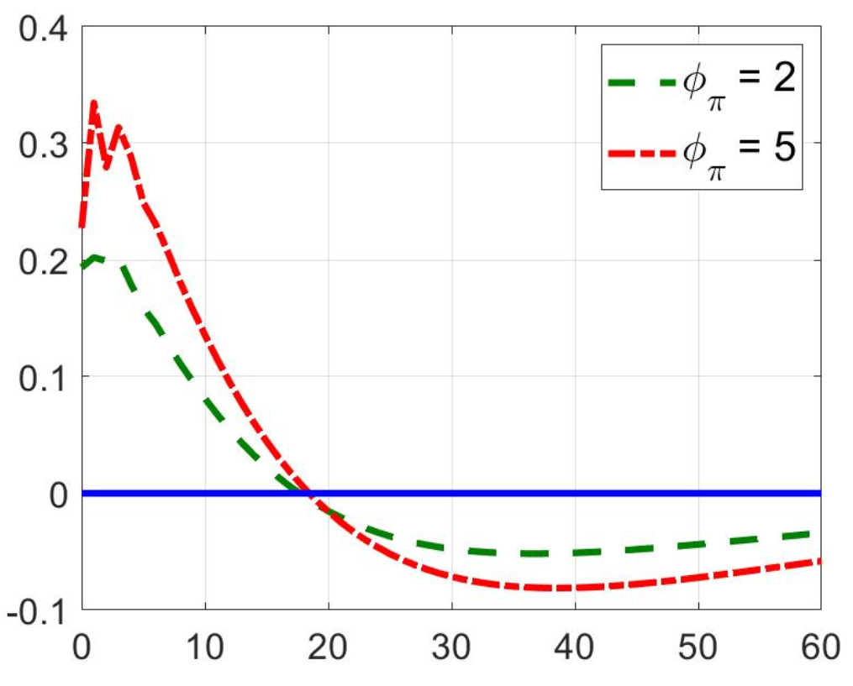
The role of green innovation for welfare
Assume there is no innovation in the green sector
Implications for monetary policy would change: Higher weight on inflation stabilization desirable
Present value of consumption-equivalent loss
Period-by-period consumption-equivalent
losses and gains

Slide 18
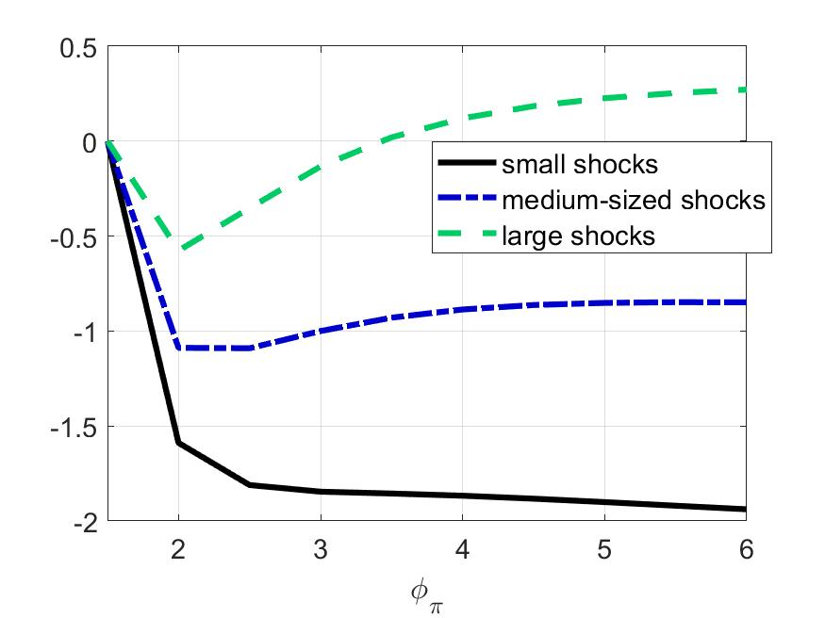
Transition dynamics and business cycle shocks: adding demand and supply shocks
Consumption equivalents: the trade-off between stabilizing the carbon tax shock or business cycle shocks depend on their relative size

Slide 19
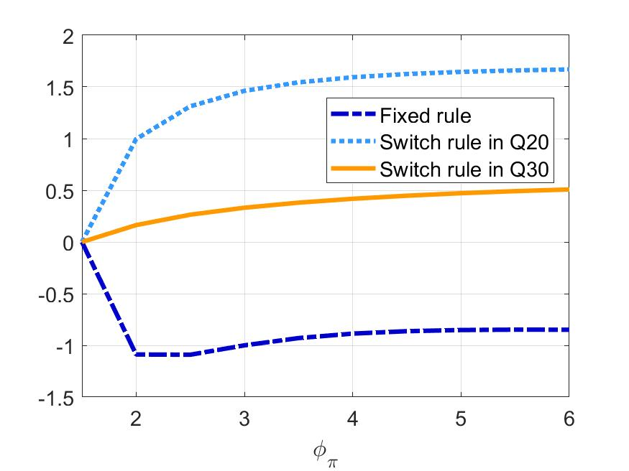
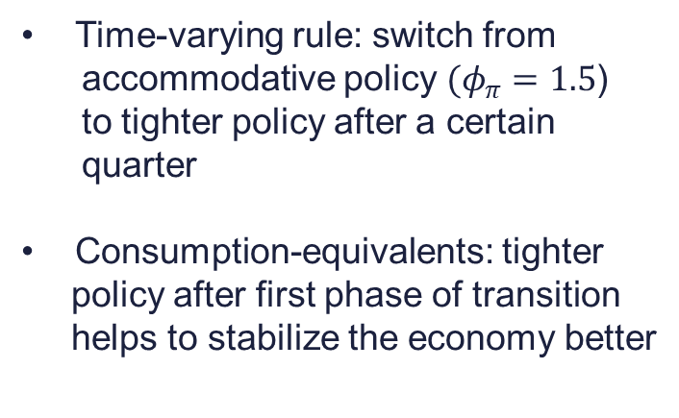
Transition dynamics and business cycle shocks: time-varying MP rule
Time-varying rule: switch from
accommodative policy $(φ_{π}=1.5$)
to tighter policy after a certain
quarter
Consumption-equivalents: tighter
policy after first phase of transition
helps to stabilize the economy better

Slide 20
Conclusion
Finding:
  In the face of an energy transition
  even central banks focusing on core mandates of price-economic stability
  might find it useful to implement more accommodating monetary policy
  in order to speed up transition
Intuition:
  Stronger output today does not only contribute to consumption,
  but stronger (energy) demand that helps green innovation
Contribution: combine standard models consistent with energy transition to obtain new and policy relevant findings for monetary policy
  Informs central banks as they review monetary policy strategies for climate change

Slide 21
Thank you for your attention!
Flora BUDIANTO | flora.budianto@tuwien.ac.at
Előd TAKÁTS | elod@uni-corvinus.hu
Bank of Albania – LSE conference | 26-27 October 2022

