Slide 1
Covid-19 Impact on Economy and CB Policies Bank of Albania – London School of Economics 29 October 2020
Boris Vujčić, Governor

Slide 2
COVID-19 short-term challenges

Slide 3
CNB’s reaction to the crisis
When the crisis started in March, the CNB reacted by releasing liquidity reserves, with several main goals:
preserving EUR/HRK stability,
ensuring Kuna and FX liquidity of the domestic financial system and
preserving stability in the government securities market.
Up to now - no need for classical macroprudential instruments - monetary and supervisory measures sufficient for preserving financial stability.

Slide 4
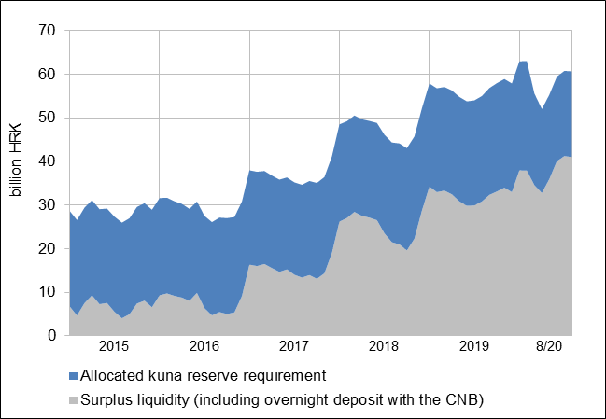
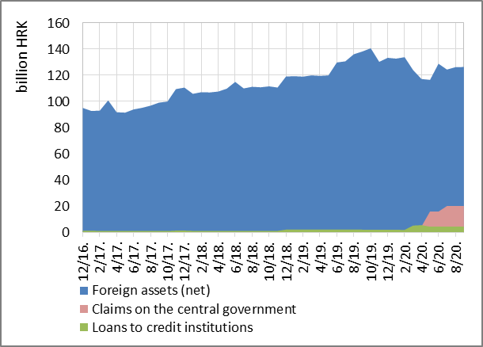
Most relevant monetary measures
High liquidity of financial system has been preserved
FX interventions (5.7% of GDP)
+ arranging currency swap line with ECB – 2 EUR bn
Lowering GRR from 12% to 9%
Government bond purchases (5.6% of GDP)
Expanding the list of participants in operations of sale and purchase of securities to pension and investment funds and insurance companies
Weekly and long-term open market operations
Pandemic-related measures have changed the structure of CNB assets

Slide 5
Most relevant supervisory measures
Banks allowed to temporarily use the LCR ratio below 100% - supporting liquidity, ensuring favourable financing conditions, preserving EUR/HRK stability
More flexible approach to supervisory rules enabling the accelerated procedure of loan reprogramming
Banks allowed to temporarily continue classifying renegotiated and new loans to pandemic- affected clients as non-defaulting
Banks ordered to retain profits from 2019 and appropriately adjust payments of variable receipts - preserving solvency and liquidity
Temporary suspension of certain supervisory activities (e.g. stress testing)
Loan repayment moratoria and loan restructuring
data until July 30

Slide 6
Monetary policy in emerging markets going forward
Scope for unconventional policies
in EMs limited:
we do not issue reserve currencies
exchange rate considerations are usually an import factor, especially in countries with high dollarisation/euroisation
underdeveloped local financial markets – low capacity to absorb large issuances of government bonds
banks have high sovereign debt exposure
Policy space widens with:
lowering of dollarisation/euroisation and twin deficits
increase in sovereign bond issues in domestic currency
maintaining ample FX reserves
swap and repo lines with reserve currency issuers can help

Slide 7
COVID-19 aftermath

Slide 8
Unconventional monetary policies will continue in developed markets
Negative side effects of unconventional policies:
Financial stability risks of low-for-long rates (debt build-up, asset price bubbles, risky search for yield...)
Threats to central bank independence
Drag on productivity (misallocation of resources, lower corporate dynamism, competitiveness)
Monetary policy is like most medicines – it can speed-up recovery, but it is up to the immune system to restore health to its normal state. Undesired side effects expand if the medicine is administered for longer periods and if the dosage is increased.

Slide 9
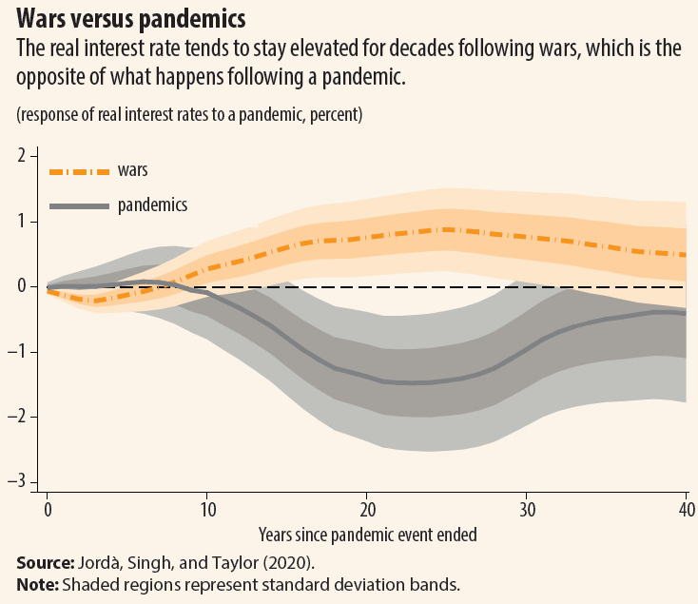
But inflation may also stay low for long? (1)
Past pandemics have been found to lead to lasting declines in the European real natural interest rate (Jordá et al., 2020)
Risks weighing on aggregate demand (prolonged uncertainty, unemployment, forgone investments) if they materialise, will be unambiguously disinflationary
ECB research finds that amid labour market disruptions, high uncertainty and financial amplification, inflation would be 0.8 p.p. lower by 2022 than the pre-crisis outlook (Angelini et al., 2020)
But structural drivers play a key role for the long-term inflation...

Slide 10
But inflation may also stay low for long? (2)
Two key processes affecting inflation outlook in the long term:
Globalisation
Digitalisation
Over the past 20 years, both globalisation and technology have tended to depress prices
At first glance, Covid-19 seems to lead to these forces pulling in opposite directions – reversal of globalisation on the one hand and accelerated digitalisation on the other. But the picture is not black and white.
Covid-19 revealed weaknesses in globalisation (inequity, fragility...), causing rise of nationalism, protectionism
Still, Covid-19 will not kill globalisation, but reshape it, and in some segments accelerate it, backed by rapid digitalisation – two processes reinforce each other

Slide 11
1. Globalisation
New wave of globalisation will entail structural changes:
Global supply chains restructuring
Relocation, reorganization of supply chains, sourcing diversification, refocusing from costs to flexibility and resilience (this could increase cost pressures, but firms tend to offset them with accelerated automation)
Globalisation of services
Globalisation broadens the market for tradeable services (IT, medicine, education...)
Virtual meetings become substitute for travel and physical meetings, with their greater efficiency leading to higher levels of engagement
E-commerce
Consumers and sellers move online, national borders become less relevant
Container shipping industry displayed surprising resilience, partly due to boom of e-commerce
Labour market
Globalisation broadens the pool of workers available to firms, generating downward wage and cost pressures

Slide 12
2. Digitalisation (1)
Pandemic has changed the way we work, shop, pay:
Working remotely
In Europe nearly 50% of the employees teleworked in the pandemic; majority wishes to continue at least occasionally
Telework can improve productivity by raising worker satisfaction (better work-life balance, less commuting, less absenteeism), reduce costs (reducing office space and equipment)
But, worker efficiency may also decrease due to lack of personal communication, knowledge sharing, managerial oversight - need for the right balance

Slide 13
Working remotely
Preference regarding regularity of working from home if there were no COVID-19 restrictions, by teleworking status, EU27 (%)
Source: „Living, working and COVID-19”, Eurofound - European Foundation for the Improvement of Living and Working Conditions

Slide 14
2. Digitalisation (2)
Automation, robotisation
Robots are key tools for boosting productivity (improving functionality & efficiency, reducing production costs)
Effects of robotisation on employment not so straightforward
A number of studies shows a positive association between robot penetration and job creation in Europe (Klenert et al., EC, 2020; Koch et al., 2019; Dauth et al., 2018)
E-commerce
Played a crucial role in maintaining economic activity in Europe
Further sharpens competition between online and traditional retailers
For the euro area, disinflationary effect of e-commerce estimated to 0.8 percentage points cumulatively in the period 2006-2018 (Anderton et al., ECB, 2020)

Slide 15
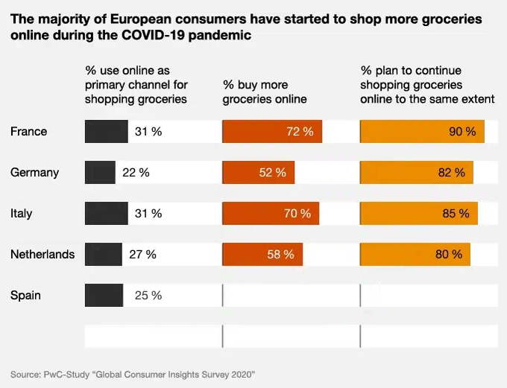
E-commerce

Slide 16
2. Digitalisation (3)
Digital payments, e-money
Cash being replaced by digital forms of money – more secure, convenient, cheaper
Implications for inflation: digital money competition could constrain central bank’s ability to produce inflation as people can switch to competing currencies (similar to dollarisation)
Conversely, CBDCs could increase the central bank’s ability to produce inflation
ECB and some other CBs looking into the option of introducing digital currencies (as a supplement to cash, not a substitute)
Potential risks: cyber risks, right to privacy, and whether a central bank issuing a digital currency means that it would acquire sensitive information on users
Banking: potential for further cost reduction becomes more and more dependent on digitalisation and financial innovation
Digitalization in banking also implies new risks - requires specific monitoring skills

Slide 17
Key takeaways
Initial policy reaction to the pandemic large, timely and appropriate
Going forward, unconventional policies subject to more limitations and risks
Short- to medium-term factors clearly pushing inflation down (uncertainty, unemployment, higher savings, less investment)
Long-term inflation drivers tilted to the downside (digitalization, globalization)
Globalisation is reshaping, not reversing – structural changes might reduce costs and bring more competition in product markets (e-commerce), services markets, labour markets
Accelerated digital transformation underway, enabling higher productivity and new jobs with higher wages
Financial stability implications – need for revisiting supervisory practices
That said, let’s not forget the forces that could mitigate disinflationary trends (i.e. demographics - ageing population)

Slide 18
Thank you!

Slide 19
Literature:
Anderton, R., Jarvis, V., Labhard, V., Morgan, J., Petroulakis, F. and Vivian, L. (2020), “Virtually everywhere? Digitalisation and the euro area and EU economies: Degree, effects, and key issues”, Occasional Paper Series, No 244, ECB, June.
Angelini, E., Damjanovic, M., Darracq Paries, M., Zimic, S. (2020), “ECB-BASIR: a primer on the macroeconomic implications of the COVID-19 pandemic”, W.P.Series, No. 2431, ECB.
Atkins R. (2019), Robotics and the Future of Production and Work; https://itif.org/publications/2019/10/15/robotics-and-future-production-and-work
Dauth W., s. Findeisen, J. Suedekum, N. Woessner (2018), Adjusting to Robots: Worker-Level Evidence, working paper, Opportunity & Inclusive Growth Institute, August, https://www.minneapolisfed.org/institute/working-papers-institute/iwp13.pdf.
Eurofound (2020), Living, working and COVID-19, Publications Office of the European Union, Luxembourg.
Fiedler, S., Gern, K.-J. and Stolzenburg, U. (2019), The Impact of Digitalisation on the Monetary System, Study for the Committee on Economic and Monetary Affairs, European Parliament, Luxembourg, December.
Jordá, Ó., S.R. Singh, A.M. Taylor (2020), “Longer-run economic consequences of pandemics”, CEPR working paper, No. 14543.
Klenert, D., Fernández-Macías, E., Antón, J. (2020), Do robots really destroy jobs? Evidence from Europe, Seville: European Commission, JRC118393.
Koch, M., Manuylov, I. & Smolka, M. (2019). Robots and firms (CESifo Working Paper No. 7608). Munich: The CESifo Group. https://www.ifo.de/DocDL/cesifo1_wp7608.pdf
https://www.eurocommerce.eu/search.aspx?q=e-commerce&tag=1
https://ecommercenews.eu/the-impact-of-covid-19-on-consumer-trends-in-europe/
https://www.ft.com/content/65fe4650-5d90-41bc-8025-4ac81df8a5e4
https://hbr.org/2020/09/global-supply-chains-in-a-post-pandemic-world

