Slide 1
Stress testing for climate change
Conference co-organized by the Bank of Albania and the
London School of Economics and Political Science (LSE)
Tirana, 27 October 2022
Ralph Spitzer ^{*)}
OeNB / Supervision Policy and Strategy Division
*) The views expressed in this presentation are those of the author and not necessarily those of the OeNB or the Eurosystem.

Slide 2
Agenda
From climate risks to financial risks
How is climate risk stress testing different
OeNB’s 2021 pilot exercise to assess impact of carbon pricing
Climate risk stress testing – what is it good for?
What else can we do?

Slide 3
From climate risks to financial risks
Climate Risks
Economic transmission channels
Financial risks
Transition risks
Policy and regulation:
  Carbon Tax
  Fossil Fuel Ban
  Land-use and farming practices
Technology development
Consumer preferences
Micro (Affecting individual businesses and households)
Credit risk
Defaults by businesses and households
Collateral depreciation
Businesses
Property damage and business disruption from severe weather
Stranded assets and new capital expenditure due to transition
Changing demand and costs
Legal liability (from failure to mitigate or adapt)
Households
Loss of income (from weather disruption and health impacts, labour market frictions)
Property damage (from severe weather) or restrictions (from low-carbon policies) increasing costs and affecting valuations
Market risk
Repricing of equities, fixed income, commodities etc.
Underwriting risk
Increased insured losses
Increased insurance gap
Financial system contagion
Macro (Aggregate impacts on the macroeconomy)
Physical risks
Chronic (e.g. temperature, precipitation, agricultural productivity, sea levels)
Acute (e.g. heatwaves, floods, cyclones and wildfires)
Capital depreciation and increased investment
Shifts in prices (from structural changes, supply shocks)
Productivity changes (from severe heat, diversion of investment to mitigation and adaptation, higher risk aversion)
Labour market frictions (from physical and transition risks)
Socioeconomic changes (from changing consumption patterns, migration, conflict)
Other impacts on international trade, government revenues, fiscal space, output, interest rates and exchange rates.
Operational risk
Supply chain disruption
Forced facility closure
Liquidity risk
Increased demand for liquidity
Refinancing risk
Source: NGFS 2021
Climate and economy feedback effects
Economy and financial system feedback effects

Slide 4
Climate risk stress testing – How is it different
Solvency stress test: Horizon of 3-5 years, static balance sheet assumptions, limited feedback effects.
Climate risk stress test
Different data requirements (NACE-1 not really sufficient)
For physical risk, geolocation of business operation (or collateral) is very relevant
Transition risk and physical risk intertwined
Ideally requires long time horizons (30 years and more)
High scenario uncertainty
High model uncertainty
  Historical data and relationships not reliable
  Non-linearities & tipping points
  New production structure: changes in input/output relations within and between sectors

Slide 5
OeNB climate risk stress test 2021 – General approach
Pilot exercise at system and individual bank level
Extends proven OeNB top-down stress test infrastructure (corporate insolvency model, ARNIE)
Uses (relatively well) established data sources
Focus on transition risk with front-loaded carbon price shock as main risk driver
Compatible time horizon of 5y (2021 – 2025)
Focus on modelling credit risk impact with Austrian and foreign exposures
Additional market risk module
Market Risk
valuation losses
ARNIE
Sectoral Carbon Price Model
cost & turnover changes
Insolvency
Model
sectoral
insolvency
rates
Bank-specific
Capital Impact
Linking
Equations
PDs for all countries
Carbon price scenarios
Baseline scenario
→ Link to FSR42 Article

Slide 6
Scenario definition aligned with NGFS narratives
ECB/EBA macroeconomic scenario baseline (ST 2021) as starting point
Orderly and disorderly transition shocks (inspired by NGFS narrative)
Carbon price introduced as additional tax in all EU countries, on all GHGs in all sectors
Inclusion of a carbon border adjustment mechanism (CBAM)

Slide 7
Strengths and weaknesses of our framework
Strengths
Consistent framework with NGFS scenario narratives
Sectoral I/O analysis approach stable and reduces complexity
Uses strengths of existing OeNB ST framework (insolvency model & ARNIE)
Relatively simple and transparent
Weaknesses
EBA baseline scenario not consistent with carbon price shock scenario
No tax redistribution, no technological change, no product substitution
Static assumptions: 1) Misses dynamic interactions of a general equilibrium macro model, 2) bank level: no growth, no portfolio rebalancing, 3) company level: no newly founded companies

Slide 8
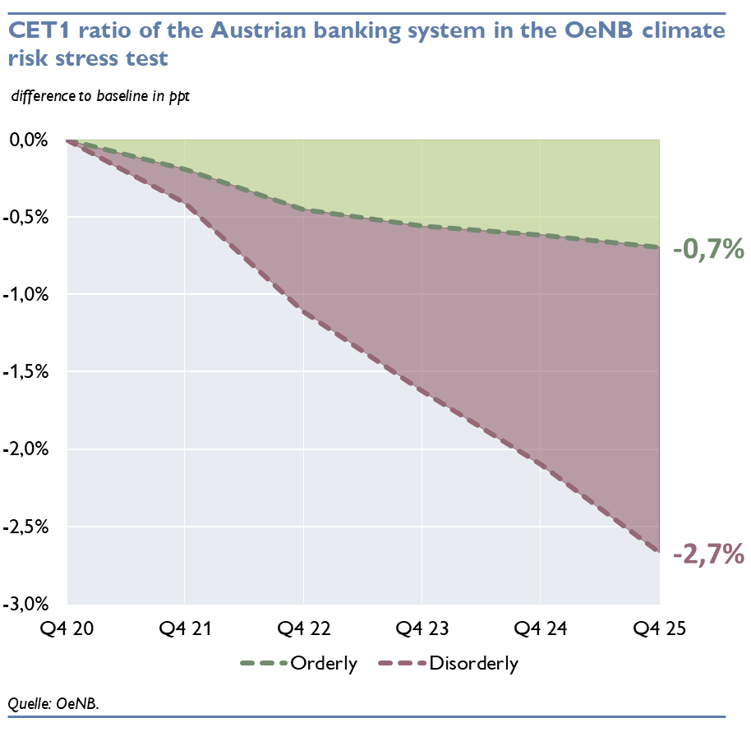
Result: Carbon pricing not a risk to Austrian financial stability
2021 EBA baseline as a reference scenario
Calculate additional impact from carbon pricing
5Y deviation from baseline 70 bps (orderly) and 267 bps (disorderly)
Main observations:
  Limited exposure to highly affected sectors
  AT exposures are less affected by transitions risks than CESEE exposures
  Strong baseline scenario (post crisis)

Slide 9
Climate risk stress testing – What is it good for?
Good for …
Creating awareness, thinking about risks and channels
Incentivising banks to
  improve own climate risk identification and assessment capabilities
  improve risk governance
  actively manage concentration risk and adjust business strategy
  adequately reflect climate risks in loan pricing
  collect better and more relevant data (energy performance certificates, carbon intensity, …)
Short-to-medium term projections with relative risk rankings (with a lot of caveats)
Not so good for …
Long-term projections (even with a lot of caveats)
Saving the world – Central banks cannot compensate for policy inaction

Slide 10
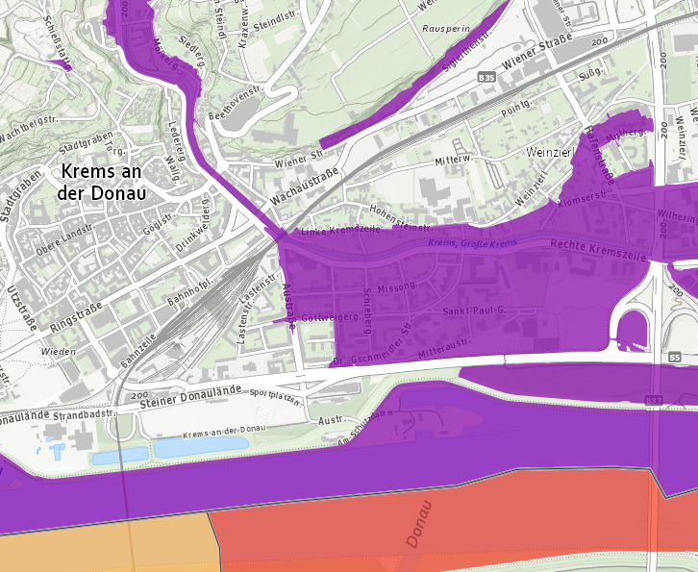
What else can we do?
Assess concentrations to GHG intensive sectors
Identify risks or scenarios relevant to local economy, for example:
  Drastic reduction in winter tourism in Austrian alpine regions over
  several consecutive years
  Exposure to flood risk
Assess banks’ dependence on interest income and fee &
commission income from GHG intensive sectors (ECB 2022, Module 2)
Assess banks’ financed GHG emissions (ECB 2022, Module 2)
Develop structural models to better capture non-linearities and sector specificities
Support policy makers with assessing policy options
Lobby for comprehensive, consistent and processable data (not only in banks, but also in firms, authorities, local and central government)

Slide 11
ANNEX

Slide 12
Sectoral Carbon Price Model shows most affected sectors & regions
A - Agriculture, forestry and fishing, B - Mining and quarrying, C – Manufacturing, D - Electricity, gas, steam and air conditioning supply, E - Water supply & sewerage, F – Construction,
G – Trade, H - Transportation and storage, I - Accommodation and food services, J - Information and communication, L - Real estate, M - Professional, scientific & techn. Services,
N - Administrative and support services, P – Education, Q - Human health and social work activities R - Arts, entertainment and recreation, S - Other service activities

Slide 13
Insolvency rates: Agriculture and transportation most affected

