Slide 1
Macroprudential policies at the time of monetary policy tightening
Reiner Martin
Director - Head of Research, National Bank of Slovakia
‘Inflation is back: How to deal with it under heightened uncertainty’, Tirana
26./27.10.2022

Slide 2
Introduction
Macroprudential policy is a relatively new economic policy tool
Countries have a maximum of 20 years experience, most have much less
Many countries never used macroprudential policy in a high-inflation / monetary tightening environment
Hence, it is currently particularly challenging for policy makers to assess the impact of macroprudential tools and its interaction with monetary (and other) policies
Question was discussed in more detail at a recent SUERF/NBS Workshop, bringing together national authorities and international organisations www.suerf.org/nbs

Slide 3
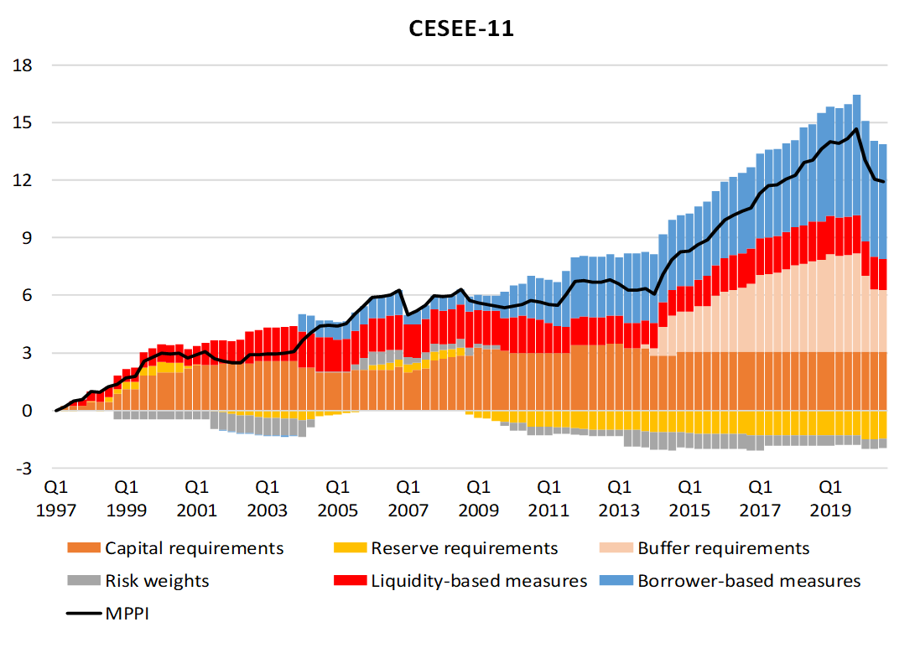
Scope for Macroprudential Loosening?
Figure 1: The Use of Macroprudential Measures in CESEE EU Countries
Source: Eller, M., R. Martin and L. Vashold, 2021. CESEE’s macroprudential policy response in the wake of the COVID-19 crisis, Focus on European Economic Integration, Q1/21. OeNB. 55-69

Slide 4

Macroprudential and Monetary Policy Interaction
Monetary Policy ‘leaning against the wind’ suboptimal to avoid financial ‘excesses’ – blunt tool with many side effects
Macroprudential Policy established as ‘first line of defense’ against financial imbalances/vulnerabilities
“In low interest rate / low inflation environment MPP tightening allows MP to remain accommodative for longer.” (Detken 2022)
“In higher interest rate / high inflation environment, can MPP releases allow MP to be tightened more decisively?” ??

Slide 5
Revisiting Macroprudential Objectives
Figure 2: Macroprudential Policy Instruments and Objectives
Source: Detken (2022), https://www.suerf.org/docx/l_559cb990c9dffd8675f6bc2186971dc2_36403_suerf.pdf

Slide 6
Systemic Risks in the euro area
Figure 3: Euro area Systemic Risk Indicator (SRI)
SRI declined in the last two quarters (equity market and credit)
Historical patterns show that the SRI tends to peak 4-6 quarters ahead of financial crises
Models for financial crisis probabilities breach signaling threshold for some EU countries; increasing country dispersion (Detken 2022)

Slide 7
The Outlook for Residential Real Estate
Figure 4: Leading RRE Indicators and RRE-at-risk estimates
Source: Detken (2022), https://www.suerf.org/docx/l_559cb990c9dffd8675f6bc2186971dc2_36403_suerf.pdf
Note: Shaded area denotes interquartile range of various leading indicators (standardized). Leading indicators include 1,2) BLS actual and expected lending standards on house purchase loans (inverted) 3,4) BLS actual and expected demand for house purchase loans 5) BLS housing market prospects 6) consumer confidence 7) services confidence 8) PMI composite 9) PMI residential construction 10) economic sentiment 11) unemployment expectations (inverted) 12) construction survey price expectations 13) intention to buy a house

Slide 8
The Outlook for Residential Real Estate
Figure 5: Drivers of RRE price growth in the euro area
Monetary policy, mortgage supply, housing preferences and supply and income shocks were ‘traditional’ drivers of real RRE price growth
Most recently, housing preferences turned negative; monetary policy and income weakened, mortgage supply disappeared
Source: Detken (2022), https://www.suerf.org/docx/l_559cb990c9dffd8675f6bc2186971dc2_36403_suerf.pdf

Slide 9
The ESRB ‘General Warning’
ESRB warning on vulnerabilities in the financial system (22 September 2022)
Risks pertain to: (i) the deterioration of the macroeconomic outlook, (ii) […] a (possible) sharp asset price correction, and (iii) the implications of such developments for asset quality.
Recommendations include:
  ‘Close coordination between relevant authorities and prudent risk management practices across all financial sectors and market participants
  ‘Preserving or further building up macroprudential buffers would support credit institutions’ resilience and enable the authorities to release these buffers, if and when risks materialize and negatively impact credit institutions’ balance sheets.’
  ‘Macroprudential policy decisions should be made considering Member State-specific macro-financial outlooks and banking sector conditions.’
  There is no explicit reference to the use of borrower-based measures

Slide 10
Inflation, Monetary Policy Tightening and Risks
Rising inflation and tightening monetary policy affect financial sector risks in two main ways:
It reduces/stops the accumulation of systemic financial sector risks, due to pressure on demand and negative impact on the financial and real estate markets. From the MPP point of view, this is welcome.
It may result in the materialization of systemic risks if economic developments turn out to be too negative or if triggers occur.
If a) prevails, there is no clear need to ease MPP limits – but there may be some scope.
If b) happens, capital-based measures should likely be adjusted to absorb losses. The case for borrower-based measures is more complex.

Slide 11
To Release or not to Release?
Key considerations for macroprudential policy makers (capital-based measures):
What is (the outlook) for banking sector resilience?
  What is the outlook for credit losses and are they well provisioned for?
  What is the absorption capacity (Pillar 2, MPP buffers, Management buffers)?
  What is the outlook for bank capital (NII likely to improve, capital conservation?)?
Is there credit rationing in the economy?
  Releases expected to be lasting can be effective in supporting lending to constrained banks; see Couaillier et al, ECB WP No 2720, Sept. 2022)
Tightening / loosening / waiting are all conceivable options for CBMs

Slide 12
To Release or not to Release?
Key considerations for macroprudential policy makers (borrower-based measures):
The mortgage / real estate cycle is likely to turn / turning, but:
  How fast and severe will the turn be?
  Is the RRE sector likely to see a ‘soft’ or a ‘hard’ landing?
  Balance between desirable reduction of vulnerabilities and negative macro repercussions
Tightening likely to be infrequent for CBMs, loosening or waiting more likely options
Overall, MPP likely to be quite heterogenous across countries, with (1) MPP ‘stance’, (2) the stock of vulnerabilities and (3) the transmission of inflation and monetary policy on the financial sector as key determinants

Slide 13
Thank you for your attention

