Slide 1
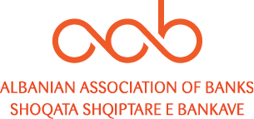
The Albanian Banking System:
Evolution and Potential Developments

Slide 2
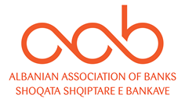
Albania essentials
Basic information
Political framework
Geographical
Official Name: Republic of Albania
Area: 28,748 km²
Population: ~ 2.87 millions
Capital: Tirana (~418 th)
Other cities: Durres (~113 th), Elbasan (~100 th)
Form of State: Parliamentary constitutional republic
Political Structure: President, Parliament of Albania with 140 seats
Structure
Socio-Economic info
Official Language: Albanian
Currency: Albanian Lek (ALL), 1 EUR = ~123 ALL
Ethnic groups: 82.6% Albanians, 0.9% Greeks, 0.2% Macedonians, 0.3% Roma, 14% not declared, 2% other
Religions: 58.8% Islam, 10% Catholics, 6.8% Orthodox, 2.5% Atheism, 8.1% Other, 13.8% Undeclared
    Elections: the last parliamentary elections have been held in 2017 (next in June 2021)
    Three major parties are:
      Socialist Party of Albania with 74/140 seats
      Democratic Party of Albania with 43/140 seats
      Socialist Movement for Integration with 19/140 seats
Parliament
Memberships
  Albania is a member of:
  United Nations, since 1955
  World Bank, since 1991
  UNESCO, since 1958
  NATO, since 2009
  WTO, since 2000
  EU candidate country from 2014
President: Mr. Ilir Meta (next elections 2022)
Prime Minister: Mr. Edi Rama
Governor of the Bank of Albania: Mr. Gent Sejko
Relevant persons

Slide 3





Macroeconomic overview
2017
2018
Real Economy
 | Population (mio) | 2.9 | 2.9
 | Real GDP (YoY % chg) | 3.7 | 4.1
 | GDP per capita (EUR ths) | 4.0 | 4.5
 | CPI (%; average) | 2.0 | 2.0
Fiscal policy
 | Public debt/GDP (%) | 66.0 | 63.6
 | Budget balance/GDP (%) | -1.4 | -2.2
MM and ex. rate
 | Money market 3m rate (%; average) | 1.3 | 1.0
 | Exchange rate/EUR (average) | 134.2 | 127.6
External vulnerability
 | Current account balance/GDP (%) | -6.9 | -7.1
 | External debt/GDP (%) | 59.7 | 56.6
 | CDS 5Y EUR (bps; end of year) | 77 | 98
 | Rating S&P | B+ | B+
Banking sector
 | Loans (YoY % chg; LC; out. am.) | 0.5 | -3.8
 | Deposits (YoY % chg; LC; out. am.) | -1.6 | -0.9
 | CAR (%) | 16.6 | 18.2
 | ROE (%) | 15.7 | 13.0
 | NPL ratio (%) | 13.2 | 11.1
Politics
  The implementation of electoral and judicial reforms in Albania will continue to be extremely challenging over the coming months, as the political environment is not conducive to consensus building
  The country is expected to continue progressing towards EU membership.
Economy outlook
  Real GDP growth will remain on a positive footing over the coming quarters (FY.2018 real GDP growth +4.1% YoY)
  As the current account is set to remain firmly in deficit over the coming years, the country will continue to cover its external financing needs with inward FDIs and FX reserves
Overall country’s assessment
  Albania's relatively low level of development means there are available factors of production and potential efficiency gains capable of yielding faster economic growth with the right structural reforms
  Lack of institutional development and endemic corruption remain key challenges to stability over the long term
Note: Last available CDS and Rating as of March 2019
SOURCE: ISP Research (March 2019), EIU, BMI Research

Slide 4
Albania’s growth driven by private consumption
Real GDP growth (YoY change, %)
GDP per capita (EUR ths)
Projections
Projections
(1)
Components of GDP (% of GDP)
GDP sectoral composition (%, 2017)
Private consumption
Government consumption
Fixed investments
Net exports
2014
2015
2016
2017
(1) It includes SI, SK, HU, CZ, HR, RS, RO
SOURCE: IMF, ISP Research, BMI Research, Central Intelligence Agency

Slide 5

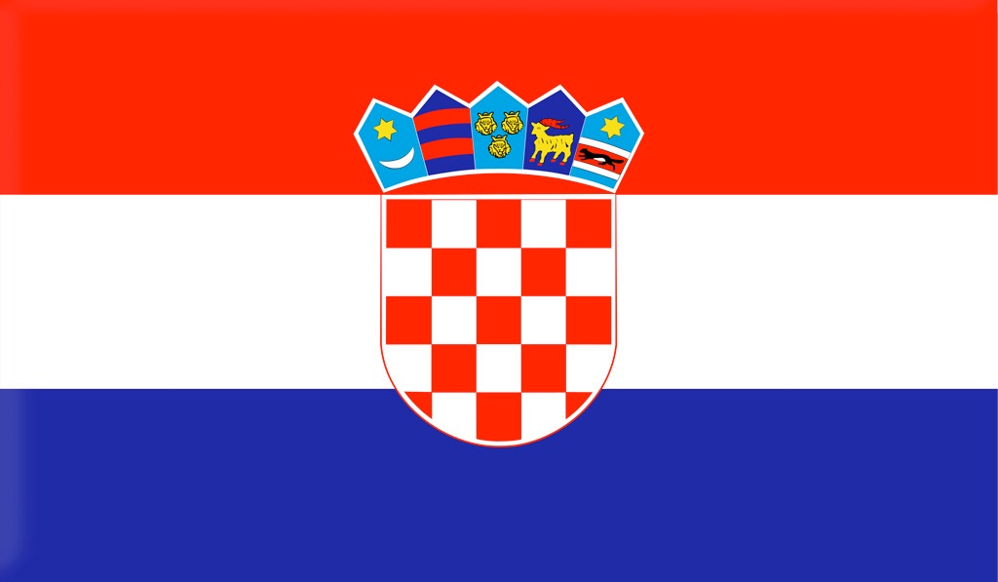
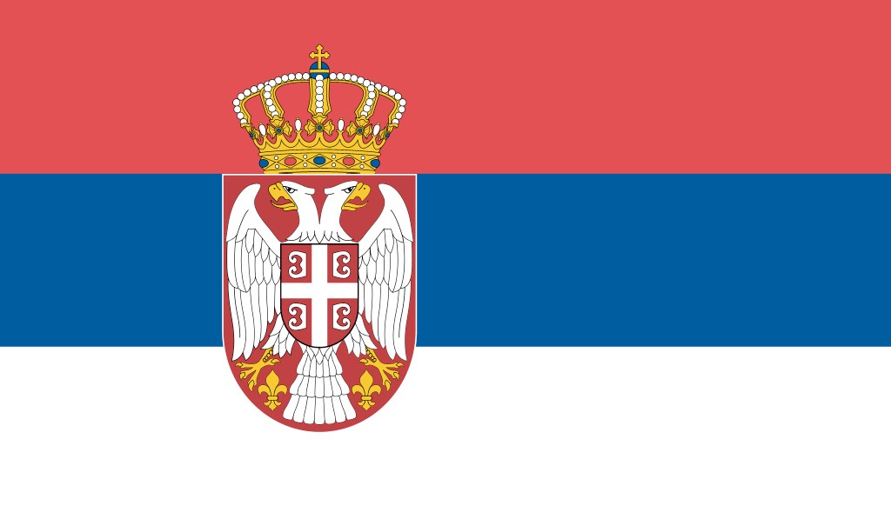
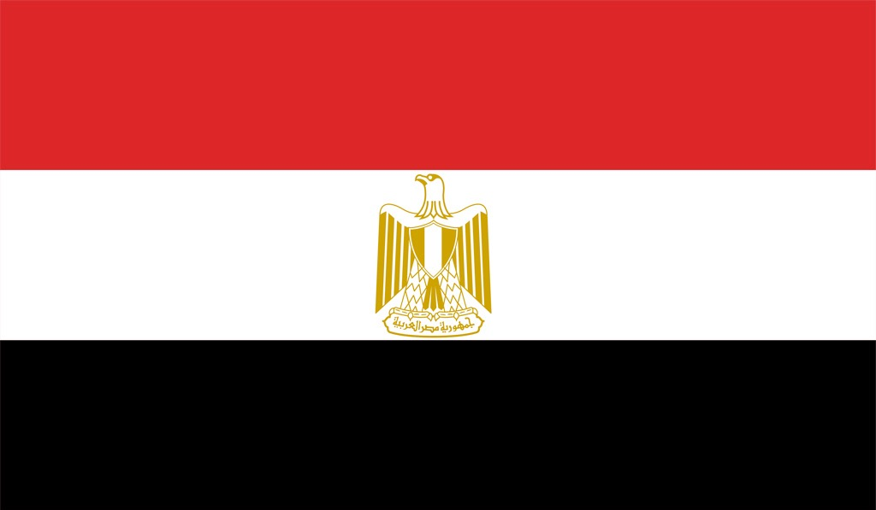
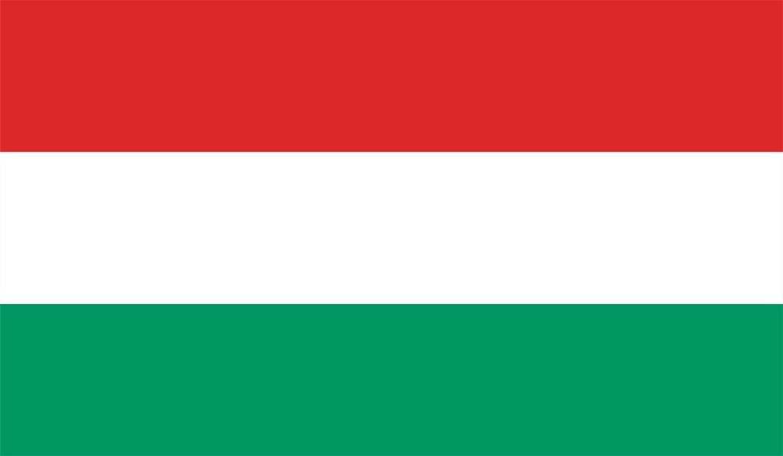





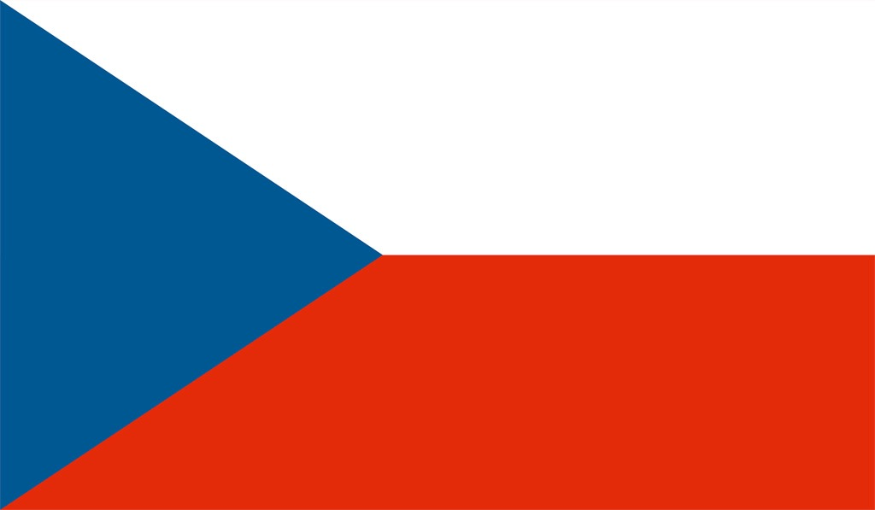











Macro structural indicators
December 2018
SK | HR | RS | EG | HU | SI | AL | BA | RO | UA | CZ | MD | CN | IT | DE | EU
1,397.0
514.0
Population
mn
12,304
15,869
1,754
3,386
GDP (nominal)
EUR bn
GDP per capita
EUR ths
26,662
43,349
3,669
7,776
Banks’ total assets
EUR bn
4
Banks’ total loans
% of GDP
S&P
A+ | BBB- | BB | B | BBB | AA- | B+ | B | BBB- | B | AA | n.a. | A+ | BBB | AAA
A+ | BBB- | BB+ | B+ | BBB | A | n.a. | n.a. | BBB- | B | AA- | n.a. | A+ | BBB | AAA
A2 | Ba2 | Ba3 | B2 | Baa3 | Baa1 | B1 | B3 | Baa3 | Caa1 | Aa3 | B3 | A1 | Baa3 | Aaa
Fitch
Country
Rating ⁽¹⁾
Moody’s
(1) Local Currency Long Term Ratings as of October 2019
NOTE: Total Assets and Loans of the EU countries granted by all MFIs excluding central banks
SOURCE: ISP Research, EIU, IMF World Economic Outlook, Eurostat, ECB, CNBs, S&P, Fitch, Moody’s

Slide 6






Social context and business climate
SK | HR | RS | EG | HU | SI | AL | BA | RO | UA | CZ | MD | CN | IT | DE
SOCIAL CONTEXT
Human Development Rank (2017)¹ | 38 | 46 | 67 | 115 | 45 | 25 | 68 | 77 | 52 | 88 | 27 | 112 | 86 | 28 | 5
Unemployment (%, 2019)²
Wealth Concentration, (%, 2015)³
Doing Business Rank, (2018)⁴ | 42 | 58 | 48 | 120 | 53 | 40 | 63 | 89 | 52 | 71 | 35 | 47 | 46 | 51 | 24
Economy Competitiveness Rank, (2018)⁵ | 41 | 68 | 65 | 94 | 48 | 35 | 76 | 91 | 52 | 83 | 29 | 88 | 28 | 31 | 3
Corruption Perceptions Rank, (2018)⁶ | 57 | 60 | 87 | 105 | 64 | 36 | 99 | 89 | 61 | 120 | 38 | 117 | 87 | 53 | 11
BUSINESS CLIMATE
(1) Composite index of life expectancy, education level, gross national income (GNI) per capita (PPP); out of 189 countries. Source: United Nations Development Programme
(2) Source: IMF (3) Income share held by highest 20% of the population. Source: World Bank
(4) Higher rankings indicate better, usually simpler, regulations for businesses and stronger protections of property rights; out of 190 countries. Source World Bank
(5) It measures the set of institutions, policies, and factors that set the sustainable current and medium-term levels of economic prosperity; out of 140 countries. - Source: World Economic Forum
(6) Ranking based on the perceived levels of corruption in each country, as determined by expert assessments and opinion surveys; out of 180 countries. The lower the rank the lower the level of corruption perceived. Source: Transparency International

Slide 7




Banking system – Structure indicators
December 2018
SK | HR | RS | EG | HU | SI | AL | BA | RO | UA | CZ | MD | CN | IT | DE | EU
Banks (units) | 27 | 22 | 28 | 38 | 32 | 17 | 14 | 23 | 34 | 77 | 40 | 11 | n.a. | 508 | 1,584 | 6,089
Branches (ths) | 1.2 | 1.0 | 1.6 | 4.2 | 2.2 | 0.5 | 0.4 | 0.8 | 4.4 | 8.4 | 1.9 | 0.3 | n.a. | 25.5 | 27.9 | 162.9
Employees (ths) | 19.5 | 20.0 | 23.1 | 115.5 | 39.4 | 9.7 | 6.2 | 9.7 | 53.7 | 133.1 | 40.2 | 7.9 | n.a. | 274.1 | 564.9 | 2,666.5
Branches x 10,000 inhabit
Employees x 10,000 inhabit.
Employees x branch
(1)
(1)
(2)
(1)
n.a.
n.a.
n.a.
(1) September 2018
(2) United Kingdom excluded
SOURCE: ECB, CNBs

Slide 8






Banking market evolution
Loans and deposits progression
Loans and deposits progression
Loans and deposits progression
Credit quality
2017
2018E
2019E
2020E
2021E
2014
2015
2016
2017
2018
1.6%
-11.7
Gross loans volume to the Private Sector
EUR billion
NPL ratio
Percent
2.7%
Deposits volume from the Private Sector
EUR billion
Liquidity
2.3%
Total volume
EUR billion
2017
2018E
2019E
2020E
2021E
-2.4
34 | 31 | 30 | 29 | 28
Loan to
Deposit⁽²⁾
Percent
Loans/GDP⁽¹⁾
Percent
Deposits/GDP⁽¹⁾
Percent
63 | 59 | 57 | 56 | 54
  Bank intermediation growth expected subdued in upcoming years
  Loans’ volume expanding slow, reflecting the high credit risk
  NPL ratio on decline trend, but still stands at a very high level
  Loan to deposit ratio expected slightly to decrease in upcoming years
Nominal (2) Private Sector
NOTE: Figures may not add up due to rounding
SOURCE: ISP Research (September 2019), IMF

Slide 9


Bank intermediation barometer
(EIB, Bank Lending Survey H1.2019)
CREDIT SUPPLY CONDITIONS
CREDIT DEMAND DYNAMICS
LEGEND
= Positive trend, the majority of the local banks surveyed see an easing of credit conditions or an increasing of credit demand
= Negative trend, the majority of the local banks surveyed see a tightening of credit conditions or a decreasing of credit demand
Nov 2018 – Apr 2019
May – Oct 2019
May – Oct 2018
May – Oct 2019
Overall
Not prevailing opinion
Mortgages
Not prevailing opinion
Households
Cons.
credit
SMEs
Not prevailing opinion
Enterprises
Large
Corp.
SOURCE: EIB, CESEE BLS H1.2019

Slide 10









Banking sector at a glance
December 2018
STRUCTURE
market size
15 banks
branches
474
employees
~6,800
BALANCE SHEET
gross customer loans
4.7 bn €
customer deposits
9.6 bn €
total assets
11.8 bn €
ROE
13.0%
P&L
net income*
144.8 mn €
cost to income
77.6%
ROA
1.2%
SOURCE: Albanian Association of banks, IMF, Bank of Albania
*SRU

Slide 11
Banking sector expands at a moderate pace
Banks’ Total Assets (EUR bn)
Growth dynamics of gross loans and deposits (YoY change,%)
Loans and deposits portfolio by segment (as of Dec. 2018, %)
Banking sector shows room for more lending
Banking activity continued to expand slowly, with NPL ratio on a declining trend, but still double digit.
The banking system is highly liquid (L/D ratio ~53%) since the deposits are channeled mostly into investments in securities and less into the lending. Deposit base almost completely based on retail deposits.
The overall level of credit to the economy is still far from its potential and the opportunities for expanding lending abound.
Loans
Deposits
SOURCE: ISBD P&C, Bank of Albania, ISP Research

Slide 12












Banking system 10 top players – Current ranking
Bank
Ownership information
Total Assets
Loans (gross)
Deposits
L/D ratio
Branches
-
= ranking by TA
Mar. 2019
Volumes
EUR (bn)
Market Share (%)
Volumes
EUR (bn)
Market Share (%)
Volumes
EUR (bn)
Market Share (%)
%
#
Major shareholder
Country
1 |  | Çalık Holding |  | Turkey |  | 26.5 |  | 17.4 |  | 25.6 |  | 65
2 |  | Raiffeisen Group |  | Austria |  | 16.2 |  | 17.4 |  | 15.9 |  | 76
3 |  | Local entrepreneur |  | Albania |  | 14.3 |  | 18.7 |  | 15.0 |  | 58
4 |  | Intesa Sanpaolo Group |  | Italy |  | 12.0 |  | 9.0 |  | 12.8 |  | 34
5 |  | OTP Group |  | Hungary |  | 6.1 |  | 9.5 |  | 6.1 |  | 35
6 |  | Alpha Bank Group |  | Greece |  | 5.4 |  | 6.8 |  | 5.5 |  | 33
7 |  | NCH Capital Inc. |  | US |  | 5.2 |  | 4.5 |  | 5.6 |  | 27
8 |  | Balfin Group / Komercijalna Banka |  | Albania /North Macedonia |  | 5.0 |  | 4.3 |  | 4.9 |  | 35
9 |  | Union of Financial Services Tirana |  | Albania |  | 4.4 |  | 4.9 |  | 4.4 |  | 36
10 |  | ProCredit Holding AG&Co |  | Germany |  | 2.3 |  | 4.2 |  | 1.7 |  | 5
3.10
0.78
2.35
1.90
0.78
1.46
1.67
0.84
1.38
1.41
0.40
1.18
0.72
0.43
0.56
0.63
0.31
0.50
0.61
0.20
0.52
0.58
0.19
0.45
(1)
0.52
0.22
0.40
0.27
0.19
0.16
Albania's central bank has granted the approval for the sale of International Commercial Bank (ICBank) in March 2019,
data are pro-formed
NOTE: Ending exchange rate used from ISBD P&C
SOURCE: Central Bank data unconsolidated in Local GAAP

Slide 13

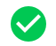

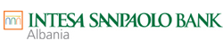





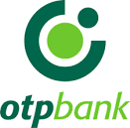


Last 3-years events
Revocation of banking licence because of voluntary liquidation process
Jun.
2019
Description
Albania's central bank has granted on March 2019 the approval for the sale of International Commercial Bank (ICBank) a subsidiary of Swiss-based ICB Financial Group Holdings and 11th bank on the market, to local Union Bank. The approved transaction involves 100% of the voting shares of ICBank. ICBank held 0.7% of total assets with a network of six branches and 94 employees.
Following the Law Decree n.99 of the Italian Parliament on the commencement and conduct of proceedings for the compulsory administrative liquidation of Veneto Banca Italy, on October 1st 2018, the Supervisory Council of Bank of Albania granted the prior approval on the merger of ISPA with Veneto Banka Sh.a..
Balfin Sh.p.k., the Albania-based company engaged in real estate development and retail business, and Komercijalna Banka A.D. Skopje, the Macedonia-based bank, has agreed to acquire 98.83% stake in Tirana Bank, from Piraeus Bank SA, the Greece-based company, for a consideration of EUR 57.3m. The transaction is subject to customary conditions, regulatory and other approvals, including approvals from Hellenic Financial Stability Fund and European Commission, Greece and Albania.
OTP Bank Plc, the listed Hungary-based commercial bank, has acquired 100% stake in Banka Societe Generale Albania SH. A., from Societe Generale SA, for an undisclosed consideration. The transaction has been completed on 29th of March 2019.
American Bank of Investments S.A., an Albania-based provider of retail and corporate banking products and services to individuals and small enterprises has agreed to acquire Banka NBG Albania Sh.A., from National Bank of Greece SA, for an estimated consideration of approximately EUR 25m. The transaction has been completed on June 2018.
Nov.
2018
100%
Oct.
2018
100%
Aug.
2018
98.83%
Aug.
2018
100%
Feb.
2018
100%
SOURCE: Mergermarket, SEE news

Slide 14





Banks by ownership origin
Ownership information
Total Assets
Loans (gross)
Deposits
L/D ratio
Branches
-
= ranking by TA
Volumes
EUR (bn)
Market Share (%)
Volumes
EUR (bn)
Market Share (%)
Volumes
EUR (bn)
Market Share (%)
%
#
Country
EU countries (6)
44
49
44
196
5.14
2.22
4.03
55
Non EU countries (5)
)
Mar. 2019
3.88
33
24
32
36
98
1.06
2.99
Albania (3)
129
2.69
23
1.21
27
2.18
24
56
EU countries (9)
5.87
58
58
57
54
312
2.50
4.60
)
Dec. 2015
Non EU countries (5)
28
42
121
2.87
0.96
23
2.29
29
Albania (2)
93
1.41
14
0.81
19
1.13
14
72

Slide 15
Observed dynamics: 2015-2019
*AAB estimate
EU Banks
Total Assets
-14%
(out of which 9.2% from Greek Banks*)
Total Loans
-9%
(out of which 9.7% from Greek Banks*)
Total Deposits
-13%
(out of which 8.9% from Greek Banks*)
Split of Kosovo operations
Total assets ~3.3%
Total loans ~4.8%
Total deposits ~3.5%
Since Jan 2019
Non EU Banks
Total Assets
+5%
(out of which 2.6% from Greek Bank*)
Total Loans
+1%
(out of which 3.4% from Greek Bank*)
Total Deposits
+4%
(out of which 2.5% from Greek Bank*)
Albanian Banks
Total Assets
+9%
(out of which 5.3% from a Greek Bank*)
Total Loans
+8%
(out of which 3.4% from a Greek Bank*)
Total Deposits
+10%
(out of which 5.0% from a Greek Bank*)

Slide 16
Conclusions 1/2
Demographics, size of the economy as well as the macroeconomic scenario, limit the achievement of significant economies of scale.
Digital Revolution and Regulatory Framework will generate additional relevant costs. In this light, Banks have to pursue a better quality and management of their assets in order to maintain an adequate level of profitability.
The ongoing consolidation process is a clear answer to the described scenario.
In this current scenario (net of the impact generated by the 2 Greek Banks):
  EU based Banks seem to be enough stable and maintaining the leadership in the market.
  Local Banks have gained market share and seem to show a faster development speed in terms of volumes
Split of Kosovo operations has impacted the comparative analysis
Given all the events will deploy their full impact this year, we shall wait 2019 final figures for confirmation of the observed trend.

Slide 17
Conclusions 1/2
It is very likely the EU based Banks are driven by more sophisticated models (risk management, capital optimization, etc) seeking for efficiency , asset quality as well as profitability rather than expansion.
Next challenges we can expect:
  Possible further consolidation
  Changes in the applied business models
  Development of synergies with Fintech companies
  Higher competition in Retail Market
Very low interest rates market, coupled with the slowing down European economy, make this “game” even more difficult, should the scenario further deteriorate.
Nevertheless, the evident solidity and liquidity of the Albanian Banking System mitigate the downside risks.

Slide 18
Thank you!
Banks speak with one voice!

