Slide 1
A financial Student Card
It’s potentials and benefits…
Eneida Thomaj, MD PayLink

Slide 2
01
03
Student Card Design
It’s Acceptance
02
04
It’s Potential
Additional Functionalities
Few explanaitions about the elements of the design
Loyalty schema and other benefits
Some statistics in terms of financial inclusion potentials
Additional services that add value to the Student Card

Slide 3
Student Card Design
It’s elements…

Slide 4
An Albanian Financial Student Card!
The Municipality of Tirana in a joint project with Union Bank and PayLink have launched the first Financial Student Card in the market.
Please see the following link: https://www.facebook.com/unionbankalbania/videos/

Slide 5
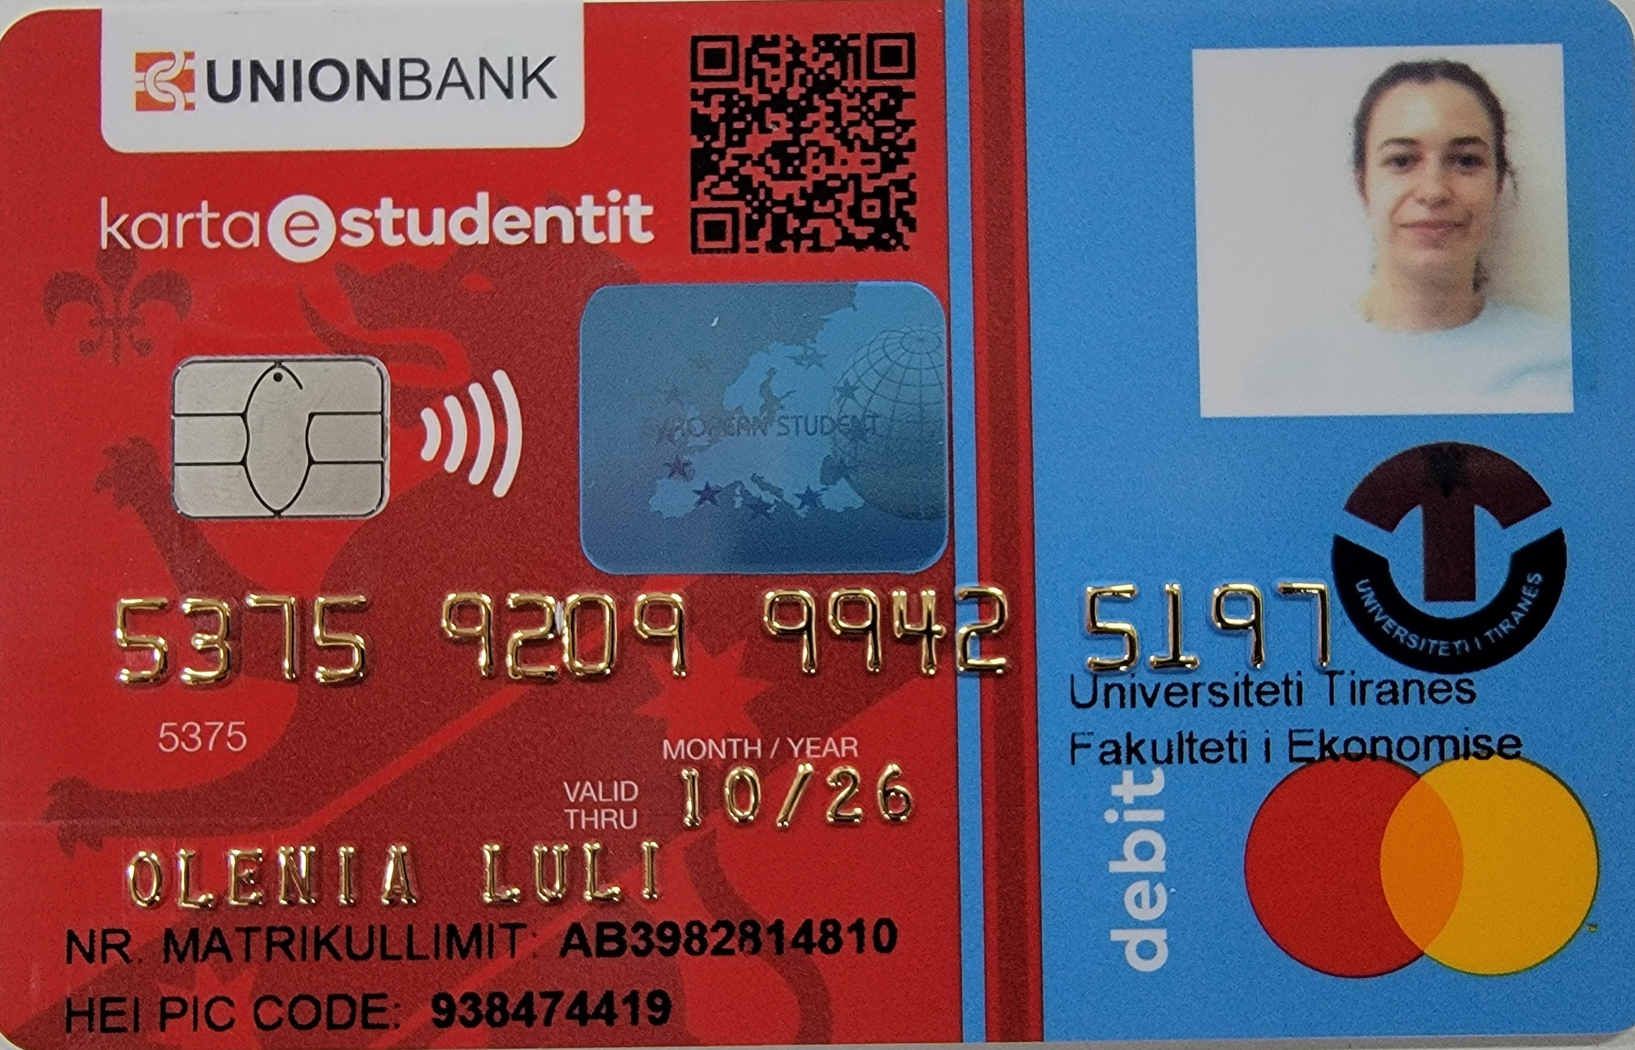
Issuing Bank
Hologram European Student Card
QR Code
Student Photo
Financial Cards Elements: Name, Surname, Card No; Exp; contactless chip; Payment Schema
University Logo
Student ID Number

Slide 6
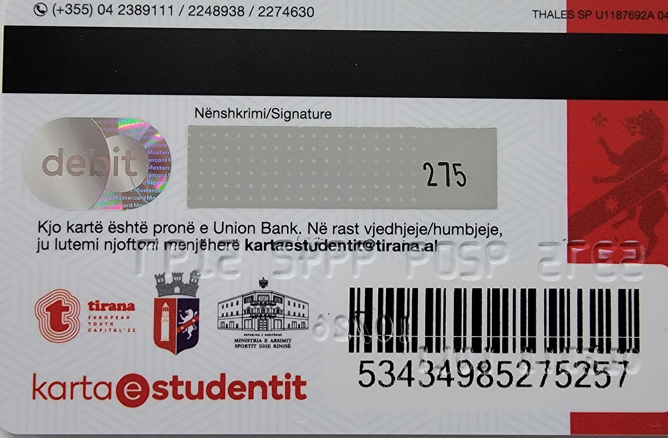
Contacts from the Issuing Bank Help Desk
CVV
Bar Code
Municipality LOGO

Slide 7
02
Student Card Potentials

Slide 8
What are the numbers?
The Financial Student Card was launched on October 2022
For the academic year 2022-2023 are expected 20K financial Student Cards
In total for the acedemic year 2022-2023 there are 124K students. Approximately there are 120K new students / year

Slide 9
Where we
want to be
What can be achieved?
Increase of Financial Inclusion of this targeted group of the population by providing a easy and everywhere accepted tool for payments
The Student Card is the perfect tool to achieve financial education for Students before a standard occupational relations is achieved.

Slide 10
03
Student Card Acceptance
Network of Loyalty Schema…

Slide 11
812 merchants a Student Card can bennefit discounts
HEALTH
LEISURE
Hospital, Pharmacy dental clinics..
Library, museums, sport, art
24%
16%
FASHION
OTHERS
Clothes, Beauty..
Electronics, Coffee, Food, …
14%
54%

Slide 12
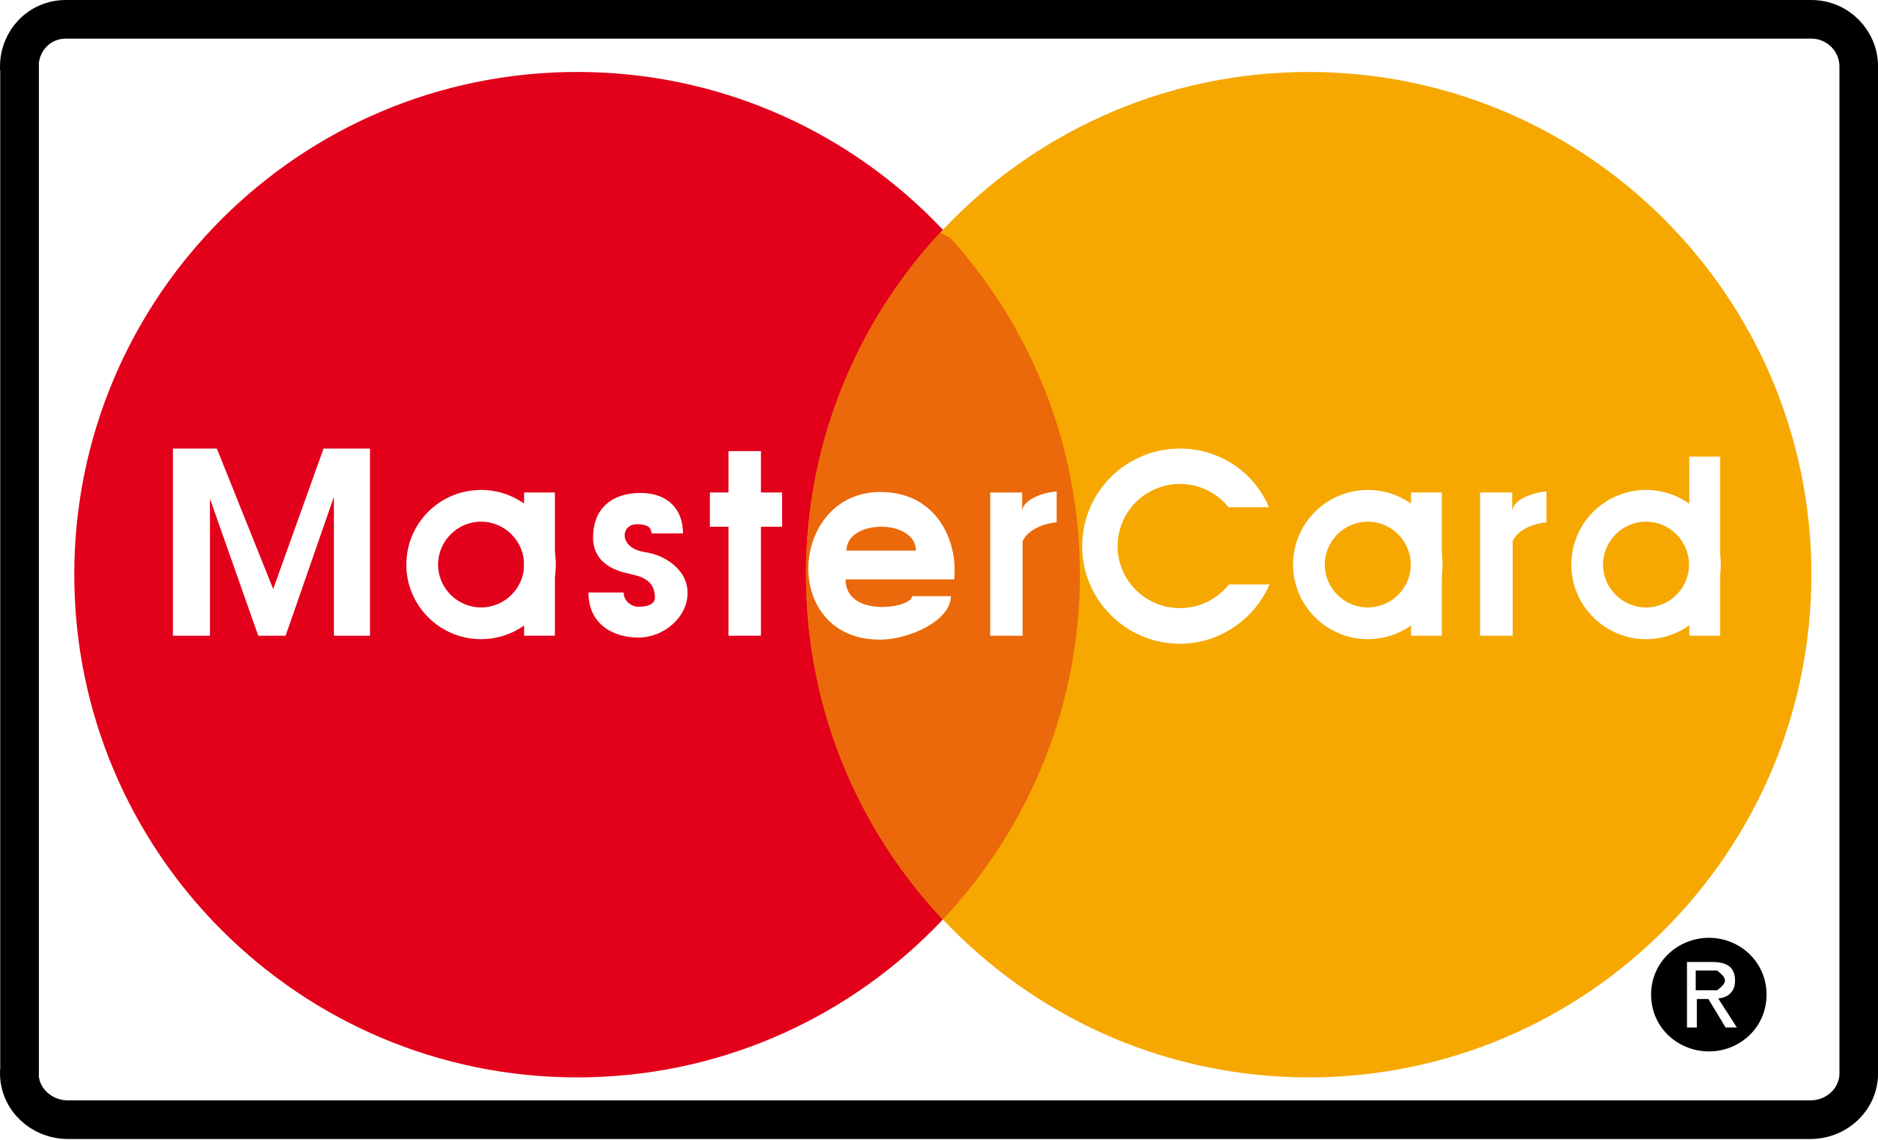
The Student Card can be accepted not only in Albanian terminals but anywehere there is a MC logo acceptance.
In all cases, the Student is identified being in this category, and benefits loyalties associated to this segment!

Slide 13
04
Additional Functionalities

Slide 14
Adding Value
G
T
Government Benefits
Transportation
Easy identification of this segment by using the card as a payment tool by directly applying student social benefits
This card can be used to deliver government benefits for Students
A
P
Access Card
Portfoglio Management
Easy to use as access card in University environments.
The card can be associated to periodical reports useful for personal portfolio management

Slide 15
Come and join the financial Student Card!

Slide 16
Thank you!
www.paylink.al

