Slide 1
Central Bank Policies as a response to COVID-19 Focus on the region
Anita Angelovska Bezhoska,
National Bank of the Republic of North Macedonia
Notes:
First of all many thanks to governor Sejko, colleagues from CB of Albania and LSE for the invitation to be part of this conference.
In my introductory speech I would like to
Shed some light on the following aspects:
-How have central banks in the region responded to challenges related to pandemics?
-Have their responses been effective?
-Is there still room for loose MP?
-What are the possible side effects of this?

Slide 2
World is faced with unprecedented shock that impacts all economies across the board in a synchronized manner
Notes:
World is faced with unprecedented shock that impacts all economies across the board in a synchronized manner.
Only 26 countries in the world are expected to be in the positive growth territory this year.
Unfortunately, none of them is country from our region, as all economies are expected to experience decline of GDP in the range of -2.5% Serbia to -12% Montenegro.

Slide 3
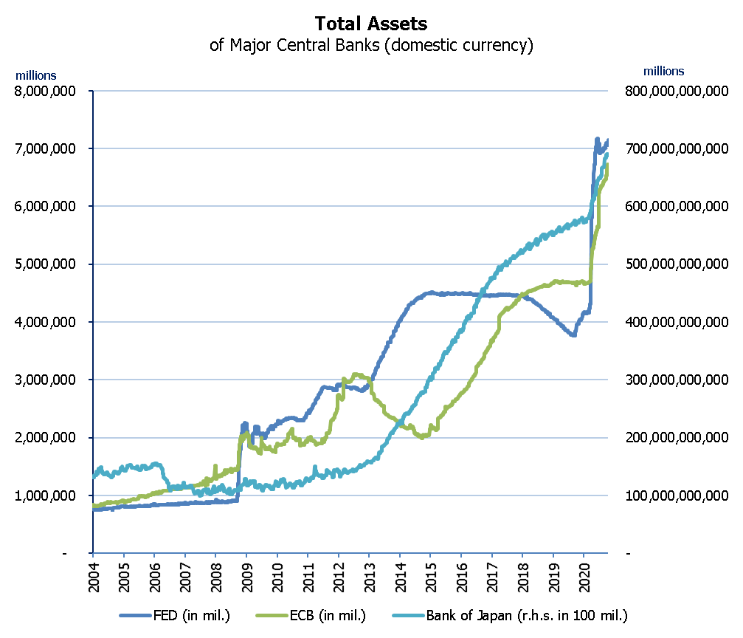
How have central banks navigated in unchartered waters?
Unprecedented shock-unprecedented policy response
This time monetary response is better balanced with fiscal response, swifter and stronger, especially in advanced economies…
Still, crisis event in which also a number of emerging economies started deploying unconventional tools (purchase of gov. securities, corporate debt, mortgage-backed securities) for the first time
Notes:
Unprecedented shock required unprecedented fiscal and monetary policy response.
Given the severity of the shock, lessons learned for the global crisis, and ready available unconventional toolkit, this time monetary reaction was better balanced with fiscal policy, swifter and stronger as visible through further cut in policy rates, from already historically low rates and huge increase of assets of CB, especially in advanced economies
For example, assets of the G10 central banks (since mid-January increased by $6 trillion that was) in the first six months increased more than double the increase seen during the first two years of the global financial crisis
Crisis event in which a number of emerging markets started deploying unconventional measures for the first time - through purchase of government bonds, corporate debt, and mortgage backed securities (Poland up to 4.5% of GDP, Turkey 1.5% of GDP, Hungary, Romania, Croatia)-

Slide 4
Reaction of the central banks in the region-monetary loosening, forex interventions and financial sector policies
Reduction of the policy rates across the board
High euroization – one of the causes for the deployment of exchange rate policies
Notes:
1. Monetary accommodation continued, to prevent tightening of financial conditions and interruption of credit flows, but mostly relying on conventional measures: cuts of main policy rate (0.5 to 1 p.p) from already historically low levels-we 0.75 p.p, increase liquidity through reduced RR, CB bills, repo operations, as well as through broadened collateral.
2. Exchange rate policies have been used to stabilize exchange fluctuations given the high euroization of economies ( on average 50% of all deposits are in foreign currency) and monetary strategy
3. Financial sector policies used to provide some regulatory flexibility to stimulate credit flows and alleviate burden on real sector as visible through resulting in many countries in moratoriums on debt repayment
NM is a similar story-relying mostly on conventional tools: Given the fixed exchange rate regime, the main “unconventionality” probably lies in the initial monetary policy response-this is the first crisis episode when our initial response is policy loosening and not tightening. In the past crisis episodes, given the sizable exchange rate pressures that we used to faced, our first policy reaction was tightening the monetary policy. For example, during the global crisis lower capital inflows and increased preferences of domestic agents for euro, warranted increase in the policy rate to stabilise expectations which lead to increased interest rates of loans and significant deceleration of credit flows. This time was different, the pandemic crisis caught us amidst strong buffers in foreign reserves, stronger fundamentals, and absence of disequilibria mirrored in the favourable external position and contained inflation.

Slide 5
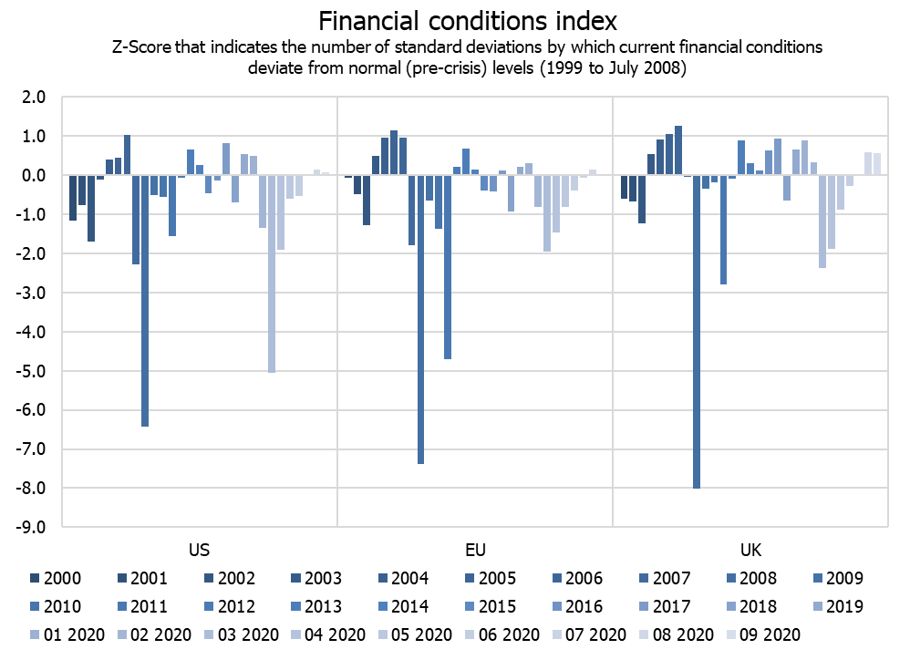
Have the interventions been effective?
Despite the tightening of the global financial conditions, especially for emerging economies, financial conditions in the region have remained rather favourable and credit flows solid
Notes:
1.Cost of financing did not increase but continued to edge downward-on average it declined by 0.2 p.p.
2. Credit growth continued to grow steadily almost in all countries-in our case it even accelerated. Average credit growth in the region is about 6.2% very similar to credit growth of last year 6.8%.
This rather favorable developments are underpinned also by good buffers that banking systems in the region had, when crisis hit.

Slide 6
Is there still room for further accommodation?
Still positive spreads to the ECB interest rate
…and forex reserves remained strong, despite interventions in some countries
Notes:
Despite the reduction, policy rates and the spread to ECB remain positive (on average 1.2 p.p), suggesting some room through conventional instruments.
Still, depending on the country specifics the lower bound definitely for the region is not zero.
For countries with some form of stable exchange rate, foreign exchange market developments, official reserve buffers and access to euro liquidity to IFIs and ECB are key in determining the policy room for manoeuvre

Slide 7
Low interest rate environment may lead to excessive risk taking and debt build up discourage savings, spur inflation and discourage structural reforms
Possible side effects from prolonged accommodative MP?
* Data on general government debt after 2019 are IMF forecast (WEO October 2020). The benchmark for the gross national savings is 28% of GDP is taken from IMF REO, May 2016
Notes:
Not a new question, but as nowadays loose policy mix is becoming even looser gets even more importance, though maybe not enough attention:
Just to mention a couple of aspects/question widely discussed….
1.To what extent can low interest rate environment lead to excessive risk taking and debt build up, especially public debt given that despite declining trend in the last 5 years in all countries in the region higher in comparison with 2008 and in some countries above Mastrich criteria.
2. Can Further reduction of policy rate negatively affect savings, which in the region remains relatively low (average domestic savings rate 14% of GDP, average national savings rate 20% of GDP) -below some traditional benchmarks ( of 28% of GDP) based on previous fast convergence episodes?
3. Given the strong monetary and fiscal impulse and its visible effect on monetary aggregates, and not only on monetary base (as was the case in global crisis) but on broad money that tend to better correlate with inflation (money is not stuck with financial system, but has found its way to real economy), are we going to face with higher inflation in the medium-term horizon?
4. And how all this will impact implementation of structural reforms which are key for speeding up income convergence in the region.
1. Further reduction of policy rate may negatively affect savings, which in the region remains relatively low (average domestic savings rate 14% of GDP, average national savings rate 20% of GDP) -below some traditional benchmarks ( of 28% of GDP) based on previous fast convergence episodes.
2. Private debt: Following the global crisis there has been a declining trend of the private debt in all economies in the region except Macedonia, and currently it is lower in comparison with the 2008 and below MIP threshold of 133% of GDP. Still, most recent data point to a very heterogeneous picture across the region, ranging from about 27.2% of GDP in Romania to 126.6% of GDP in Croatia in 2018 (region’s average private sector debt is 73.8% of GDP in 2018), asking for vigilance.
3. Public debt:: Although before coronona crisis it was on a declining path across all countries, still significantly higher level and in some countries above Mastrich criteria (Albania, Croatia, Montenegro, Slovenia)
4. Inflation, In the period following the global crisis, despite strong wage growth in many countries inflation rate has been low for long, giving ground to the so called “wage – price puzzle”. Since the emergence of the covid shock economic activity fell dramatically, commodity prices plummeted and inflation further decelerated in all countries. Average projected inflation for the region is about 1% in comparison with 1.6% previous year. For North Macedonia 0%.
Given the strong monetary and fiscal impulse and its visable effect on monetary aggregates, and not only on monetary base (as was the case in global crisis) but on broad money that tend to better correlate with inflation (money is not stuck with financial system, but has found its way to real economy), the question is are we threatened by higher inflation in the medium-term horizon? Since these policies can be revered, the key issue, then, is whether policies are kept too loose for too long. Thus some argue that main risk is a longer-term institutional shift by governments and central banks in favour of tolerating – and even targeting – higher rates of inflation as a way of managing higher public debt loads.

Slide 8
Main challenges ahead
Continuing with accommodative monetary and financial sector policies while being mindful of financial and price stability…
…but sustained recovery is uncertain and requires building resilience for future shocks…
…asking for focus on structural policies, that would rebuilt fiscal space, strengthen institutions and the rule of law, and enhance the competiveness by adopting new processes, products and services tailored to the Covid- induced circumstances
Notes:
Од последниот извештај на Светска банка за нашиот регион: Across the Western Balkans, resilient recovery will depend on strengthening the fundamentals. In 2022 the total output loss due to the crisis is projected to be fully recovered; but ensuring greater resilience to future shocks will depend on a number of structural reforms including more effective public spending and better management of public investments; rebuilding fiscal space by heightening tax compliance, greater efficiency in spending, and new fiscal instruments, such as green taxes and digital taxation; building strong, independent, and accountable institutions; and committed adherence to the rule of law. The recent contraction in global trade and the early expectations of a shift in supply chains in addition demonstrate the importance of structural policies that enhance export competitiveness and diversify products and markets—all of which are greater in regional peers than in the Western Balkans. Moving forward, a resilient economic recovery will require the adoption of more productive processes and services that are well-adapted to the new economic realities. Regulatory changes will be needed to help firms align their business models with the new post-COVID-19 normal while moving to overcome the structural barriers to competitiveness and innovation.

