Slide 1
New Trends in Banking
What’s in store for Albania?
Heinz Wiedner
Tirana, October 11th 2019

Slide 2
Banks must adopt to low interest rates
Reduction of branches, staff and ATMs
Increasing digitization
Emergence of technology banks
From cash to electronic payments
Traditional banks to focus on advisory
Increased regulation affects banks returns
Emergence of cryptocurrencies
Inside
A Brave New World? The Future of Banking in Emerging Europe
2

Slide 3
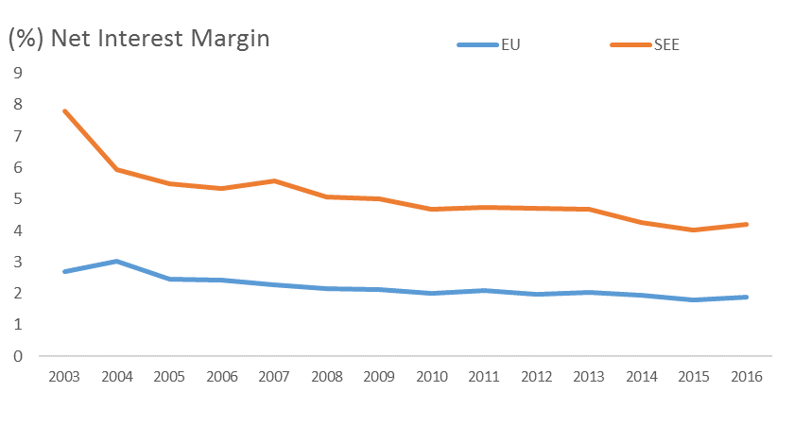
Development of Interest Margins
Banks must adopt to low interest rates
Source: World Bank
A Brave New World? The Future of Banking in Emerging Europe
3

Slide 4
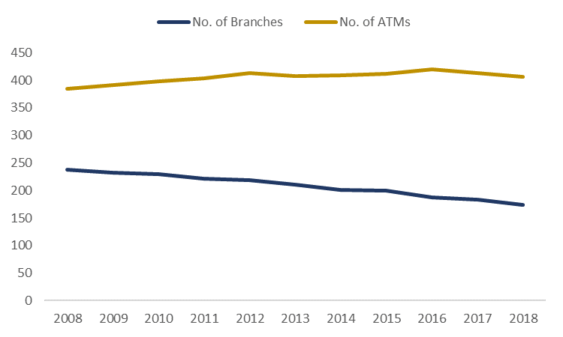
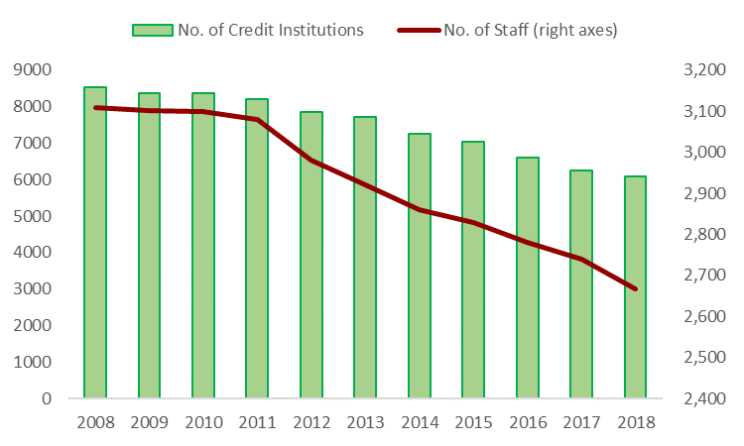
Evolution of EU Banking Sector
Reduction of branches, staff and ATMs
thousands
thousands
Source: European Banking Federation
Source: European Banking Federation
A Brave New World? The Future of Banking in Emerging Europe
4

Slide 5
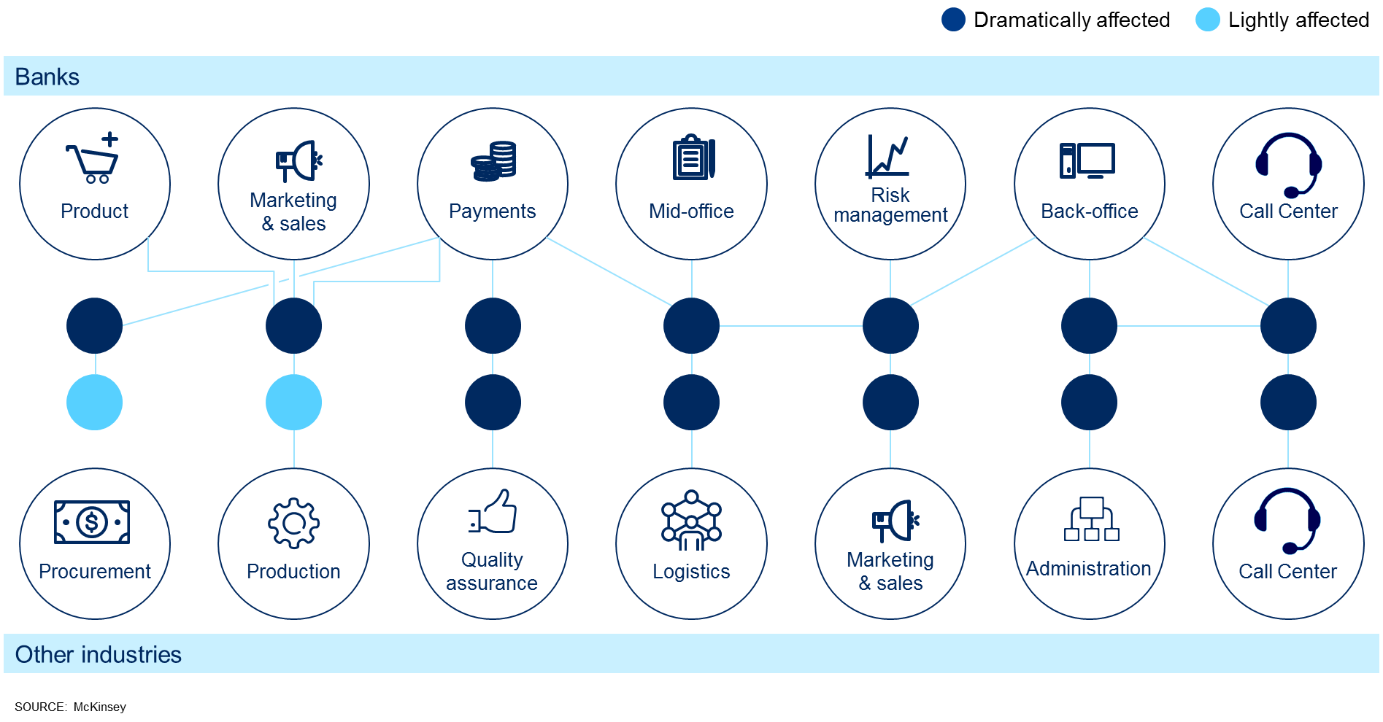
Digitization will affect all aspects of banking
Increasing Digitization
A Brave New World? The Future of Banking in Emerging Europe
5

Slide 6
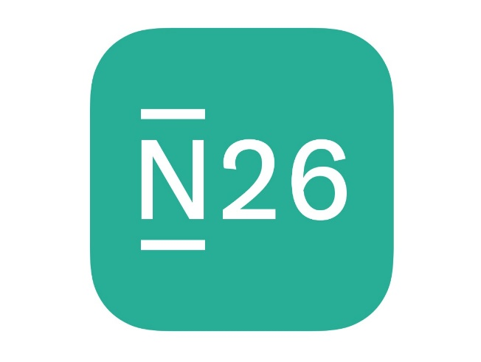
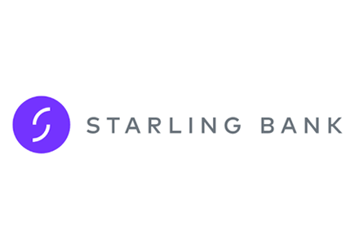
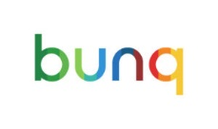
Technology Banks
Emergence of Technology Banks
A Brave New World? The Future of Banking in Emerging Europe
6

Slide 7
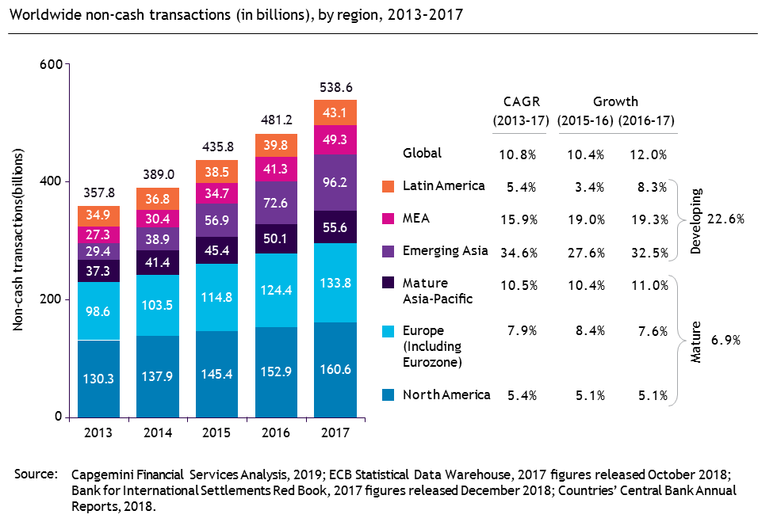
Global volumes and benefits of non-cash transaction
From Cash to Electronic Payments
A Brave New World? The Future of Banking in Emerging Europe
7

Slide 8
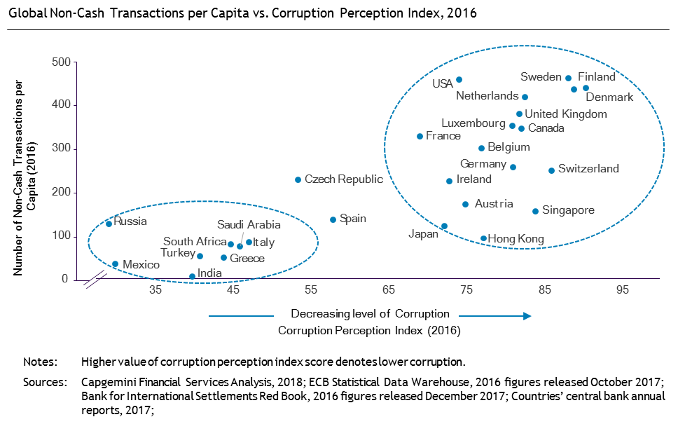
Global volumes and benefits of non-cash transaction
From Cash to Electronic Payments
A Brave New World? The Future of Banking in Emerging Europe
8

Slide 9
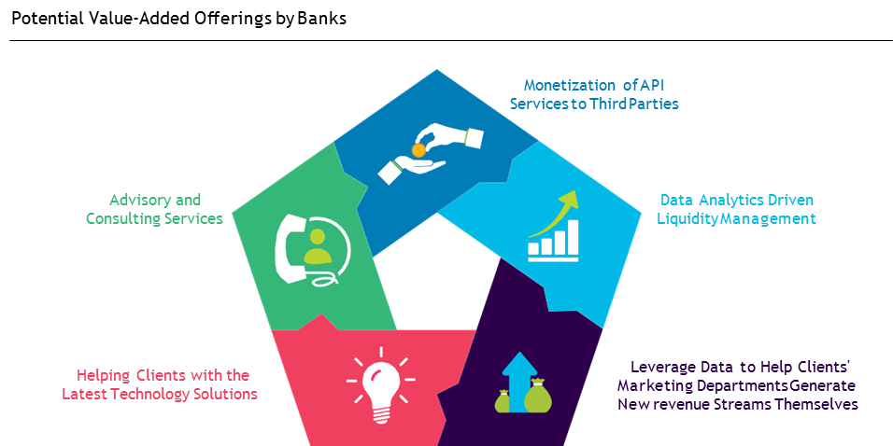
Competitive differentiators will make the difference…
Traditional banks to focus on advisory
Source: Capgemini Financial Services Analysis 2018
A Brave New World? The Future of Banking in Emerging Europe
9

Slide 10
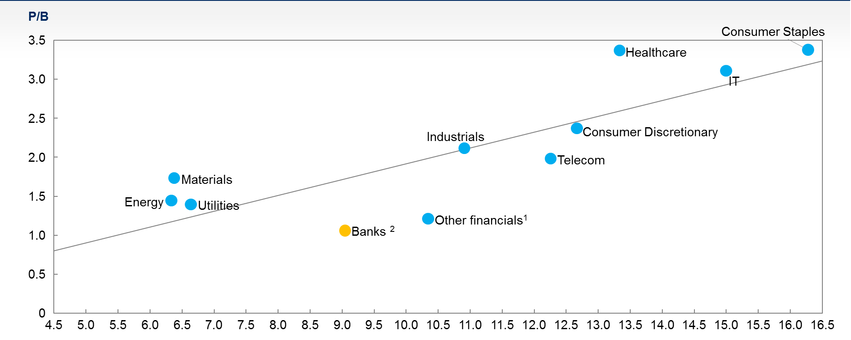
On average, from 2012 to 2017, banking valuations have lagged all other industries
ROE (%) vs P/B by industry, global (average from 2012-17)
Increased regulation affects banks returns
1 Other financials includes insurance, asset managers, private equity, real estate, payments processing companies, networks and multisector holding companies
2 Based on a sample of ~1,000 largest banks globally in terms of assets
SOURCE: S&P Global Market Intelligence, McKinsey Panorama
A Brave New World? The Future of Banking in Emerging Europe
10

Slide 11
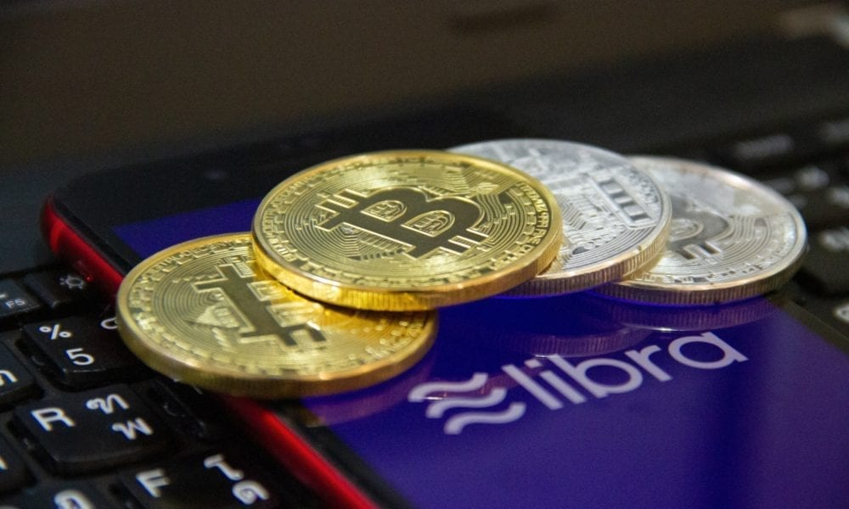
Cryptocurrencies are challenging the legacy…
Emergence of Crypto currencies
A Brave New World? The Future of Banking in Emerging Europe
11

Slide 12
ANNEX

Slide 13
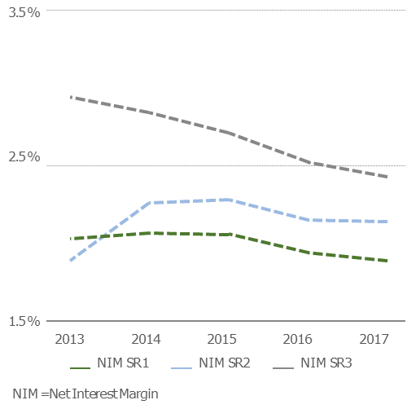
Development of Interest Margins from a study of 122 EU Banks
Banks must adopt to low interest rates
Source: BearingPoint F&R KPI Database 2018
A Brave New World? The Future of Banking in Emerging Europe
13

Slide 14
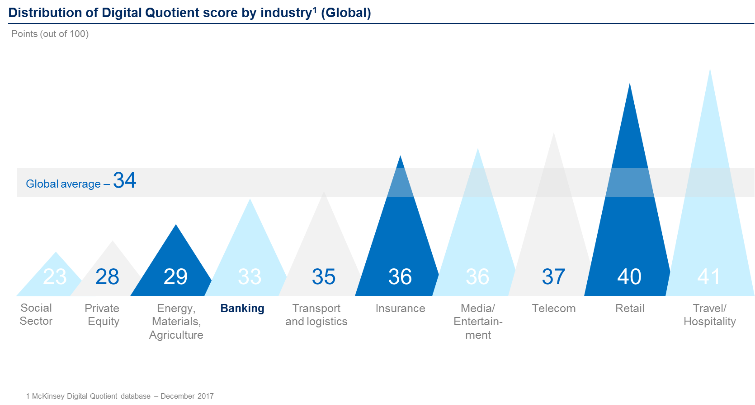
Banks lag behind other industries in level of digitization
Increasing Digitization
Source:
A Brave New World? The Future of Banking in Emerging Europe
14

Slide 15
What’s in store for Albania?

Slide 16
Evolution in Albania
Reduction of branches, staff and ATMs
Source: Albanian Associations of Banks
A Brave New World? The Future of Banking in Emerging Europe
16

Slide 17
Banks need to develop their digital identity…
Digital transformation isn’t about achieving some final state, but rather building change as a core competency
What’s in Store for Albania?
Mindset
17
A Brave New World? The Future of Banking in Emerging Europe

Slide 18
Value gap requires customer centricity…
Banks focusing on products fail to meet customer’s expectations. They should rather focus on customer’s needs
What’s in Store for Albania?
Think mobile first as Albanians are oriented towards high mobile usage
Enable digital engagement and acquisition
Branches aren’t going away, leverage their usage-sales and advisory
Seek only products/services that add measurable value for the customer
18
A Brave New World? The Future of Banking in Emerging Europe

Slide 19
Partner with Fintechs…
They are tech savvy, they are agile, they are fast and often cheaper
What’s in Store for Albania?
Embrace disruption, don’t let it destroy your value !
19
A Brave New World? The Future of Banking in Emerging Europe

Slide 20
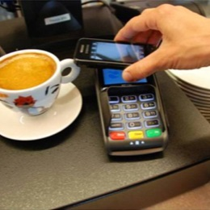
Banking is changing…
Fintech partnerships
Expanding Digital Capabilities
Data analytics/use of insights
Open Banking/Use of APIS
Commitment to Digital and Innovation
Artificial Intelligence & Blockchain
A Brave New World? The Future of Banking in Emerging Europe
20

