Slide 1

Remittances and Payments Program (RPP)
Financial Inclusion in Albania – A Payments Perspective
ALBANIA

Slide 2
IN ALBANIA, 40% OF THE ADULT POPULATION HAS AN ACCOUNT AT A REGULATED FINANCIAL INSTITUTION (FINDEX 2017), UP FROM 37% IN 2014
ACCOUNT PENETRATION IN ALBANIA (2011, 2014, 2017)
ACCOUNT PENETRATION IN THE WESTERN BALKANS ( 2017)

Slide 3
AND… USAGE OF EXISTING ACCOUNTS TO PAY ELECTRONICALLY IS EXTREMELY LOW…
NUMBER OF NON-CASH PAYMENTS PER CAPITA IN THE WESTERN BALKANS (2016) – SELECTED COUNTRIES

Slide 4
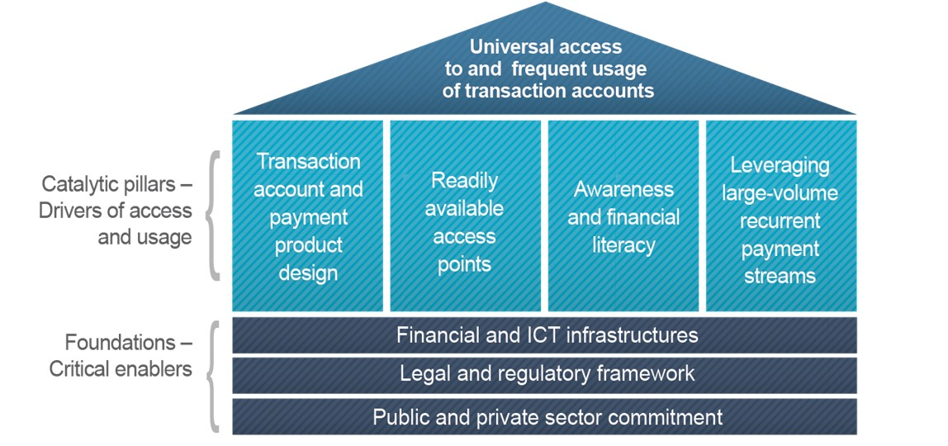
The World Bank analyzed the situation and prepared the report “Financial Inclusion in Albania – a Payments Perspective”, covering the following aspects:
4

Slide 5
The recommendations and conclusions of that report were then systematized in the Albanian Retail Payments Strategy 2018-2023, as follows:
Vision
Guiding Principles
Specific actions
Timeframe, roles and responsibilities
per foundation and catalytic pillar

Slide 6

To promote the intensive use of modern (i.e. fully electronic) retail payment instruments across the whole country, with the goal of achieving 10 cashless payments per capita by year 2023.
Supporting objectives of the NRPS
Albania will aim at achieving an adult account ownership ratio of 70% by 2023, similar to the level already achieved by middle-income countries as a whole.
Implementing the NRPS aims not only at increasing levels of ownership and usage of accounts, but also at improving the quality of payment services to customers.

Slide 7
Thank You!
Jose Antonio Garcia
jgarciagarcialun@worldbank.org
Ceu Pereira
ceupereira@worldbank.org

