Slide 1
Centennial Conference of the
Bank of Albania
Tirana, November 11, 2025
Piroska Nagy Mohacsi
Visiting Professor LSE

Slide 2
Context and four messages
Context: the World is in big transition with all the problems and challenges that come with it. But Albania and the CESEE region know “transition” and has been good at it. CEE transition has been spectacularly successful in terms of economics; political record is less even but still huge improvements
Undoing the old multilateral system has started before the current US administration & there are some positive fallouts for the World
Best news is that EMs are much more resilient to external shocks than ever before
EMs’ optimal strategy depends on their position in global finance and trade networks (and shared values)
Albania and SEE region are well positioned to make their optimal strategy a reality.

Slide 3
US policies are forcing long overdue domestic reforms – a wakeup call
Focussing on internal market deepening (not only EU but also Canada, India)
Accelerated defense spending in Europe is a huge development opportunity – don’t waste it
Germany finally managed to loosen its constitutionally enshrined debt brake
Weak US$ policy helps debt repayment

Slide 4
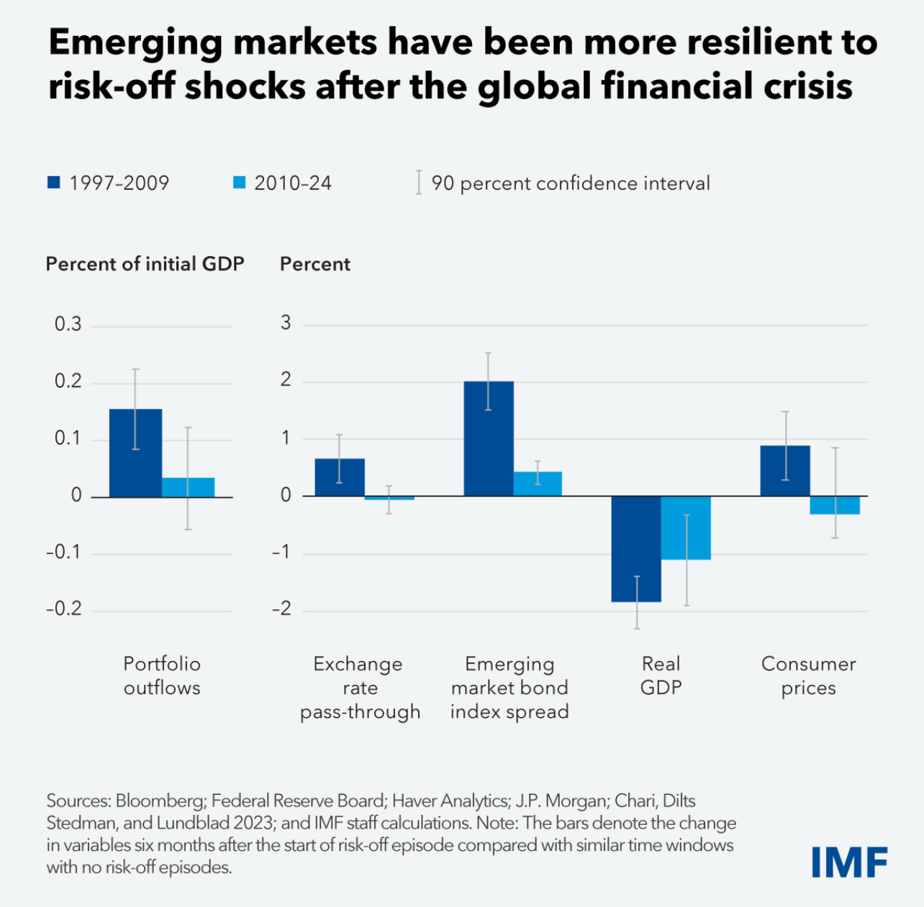
Emerging markets are incomparably more resilient than before
IMF WEO Ch 2 gives 2 reasons:
  Good policies & policy frameworks (IT better anchoring expectations; FX macropru; more floating; better fiscal frameworks all allowing for countercyclical pol)
    My research: EM central banks were actually better that Fed & ECB in addressing post COVID inflation in real time
  ”Good luck” (hmmm….)
Also: the 3 systemic global central banks finally provided good FX liquidity (swaps/repos)

Slide 5
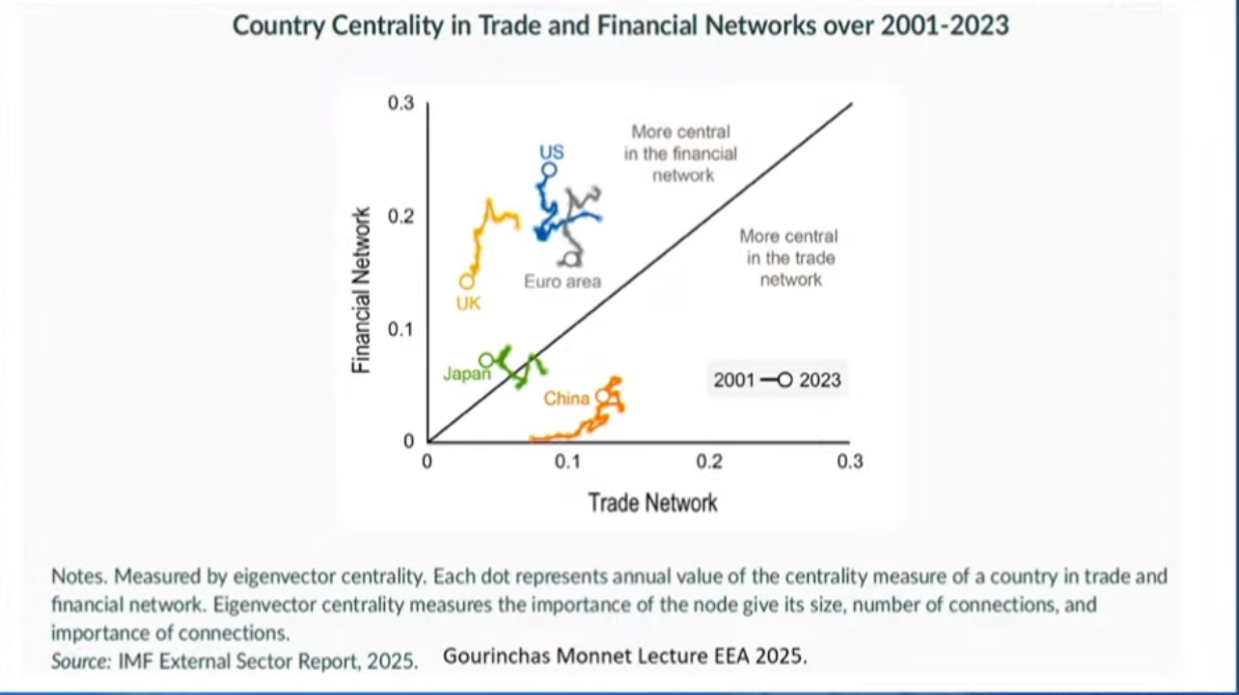
Optimal EM strategies for the global transition
The likely end-point, drawing on Helene Rey’s global financial and trade networks (2022, 2025): 3 overlapping financial & trade blocks:
  US dollar (stablecoin and US$)
  Euro – digital CBDC
  Chinese digital renminbi CBDC/ e-CNY
US$ global reserve currency role gradually weakening; ECB is still far but closest
Link to your closest trade & finance network and its central bank & formalise FX swap/repo liquidity lines
Local CBDC maybe a good idea
Note: there will likely be a financial crisis again (stablecoins; US loosening risks) for which CB cooperation will again be needed.

Slide 6
In the global chaotic transition the SEE region is lucky!
You are already on the way to your trade and financial network center – the EU/euro area
Tie EU membership to euro adoption from the start (already eurosied & need to avoid vested interest in abusing monetary policy sovereignity)
Seek now formal ECB swaps/repos. This could be part of the deepening EU integration and “global euro” project (IMF could help).

